Slide 1
Steps to stay out of plagiarism using modern tools: Introduction to Turnitin
Emmanuel Chukwudi Ihekwoaba, Ph.D
08080260062 - Whatsapp
08059792809 /08038814838 - Voice Call
emmanuel.ihekwoaba@unn.edu.ng
University of Nigeria,
Nsukka
Date: 8th May, 2019

Slide 2
Outline
Plagiarism and some tips to avoid plagiarism
Meaning of Turnitin
Purpose of Turnitin
What Turnitin looks like and How Turnitin works
Materials that can be checked

Slide 3
What is plagiarism
Using someone's ideas or words without citing appropriately (giving credit to the author).

Slide 4
How to avoid plagiarism
Print out the materials, read them understand the main idea of the writer and put those ideas in your own words.
Avoid copy and paste
Avoid reading the materials online
Ensure you always acknowledge the authors/source s you cited in your work.
Even if you did not copy the author verbatim but used his/her idea you must acknowledge the source

Slide 5
Meaning of Turnitin
Is a tool used to check the originality of written research works of students and academics
It helps one to stay away from plagiarism
Many universities in the world has adopted it to ensure academic integrity in their institutions and also check plagiarism

Slide 6
Purpose of Turnitin
for plagiarism check
students are accountable for what they submit
To check similarity of text to sources
To improve teaching and learning
To guide against misuse of online sources in research writing

Slide 7
Materials that can be checked in Turnitin
MS Word, WordPerfect, PostScript, PDF, HTML, RTF, and plain text documents
Turnitin.com DOES NOT check files in graphic formats such as TIFF, EPS, PSD, JPEG, PICT, etc.
Document Size:
Less than 40mb
Has a minimum of 25 words
Less than 400pages

Slide 8
Support tools in Turnitin
Originality Check – plagiarism detection
Grade Mark - Grading of student work
Peer Mark – students reviewing each others work
Grade Book – recording of results

Slide 9
Similarity index Indicators
BLUE (1) indicates that there are <0% matches
GREEN (2) 1%-25%
YELLOW (3) 26%-50%
ORANGE (4) 51%-75%
RED (5) 76%-100%

Slide 10
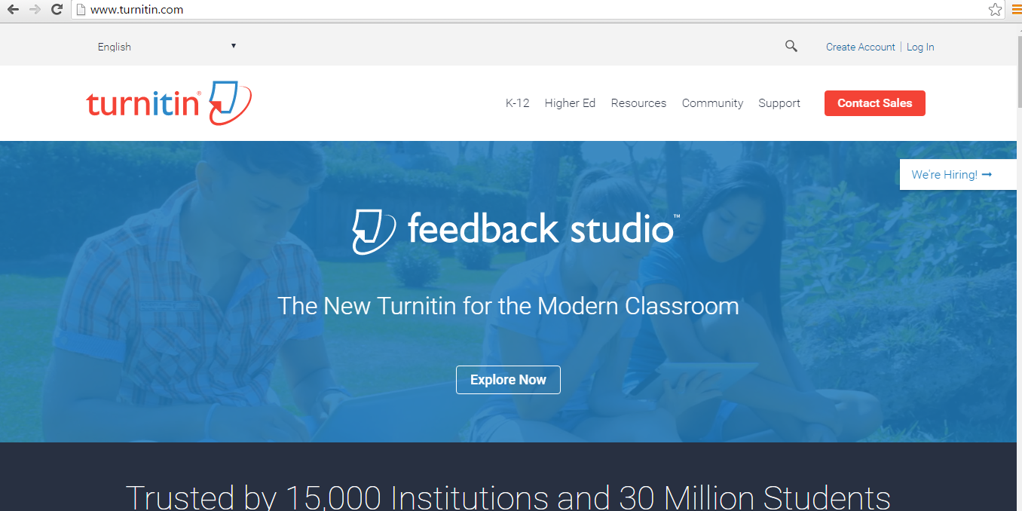
What it looks like & How Turnitin works

Slide 11
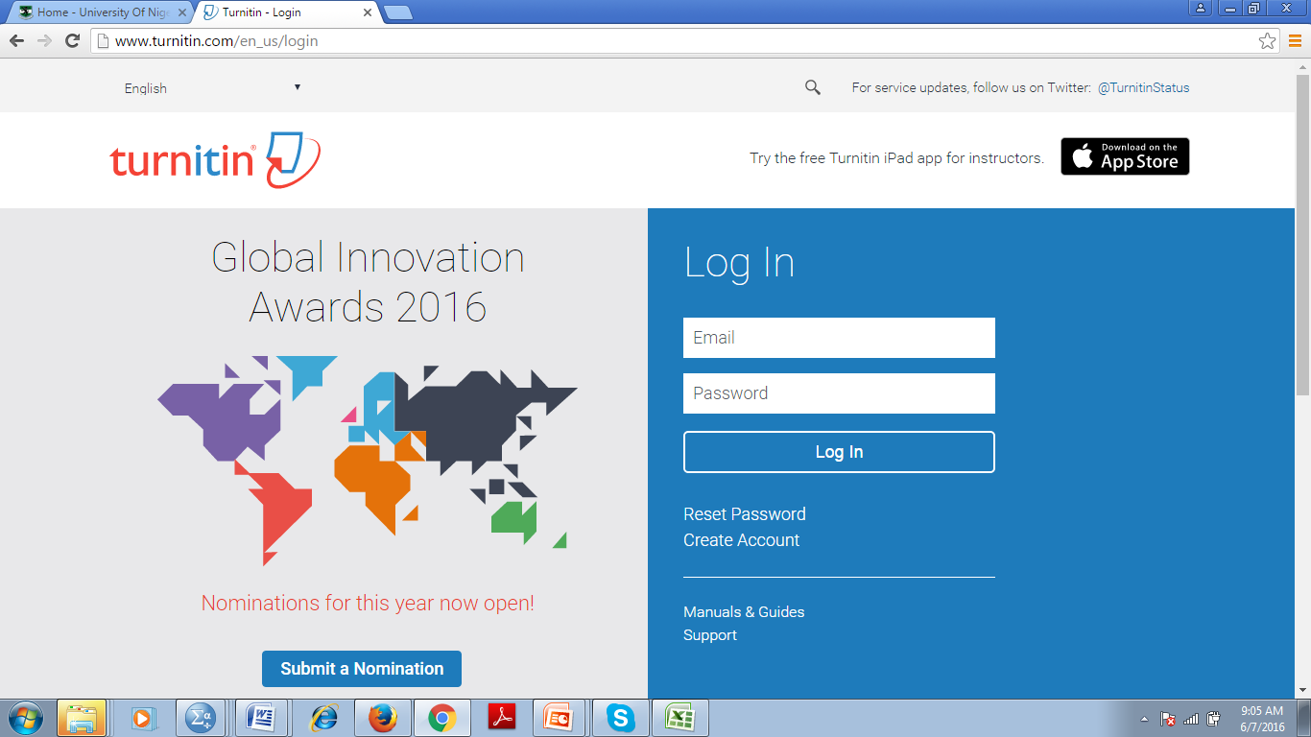
Login Page
Type in your username and password
( University email as username)
Enter your login details here
To reset your password if your cannot remember it
To reset your password click on reset password

Slide 12
Instructions for Students - to create user profiles
Go to www.turnitin.com
Click “sign up” on top menu bar
Click enrol as a student
Under ‘create a user profile’ select ‘student’ as user type.
Enter Class ID: (module code)
Enter enrolment password: (module name)
Follow instructions on the screen to create your own personal login (UNN email address) and password
(Remember your password for later assignments)

Slide 13
www.turnitin.com
Enter your username and password ( Must be University email)
For first time users
A mail will be sent to your UNN email account .
Click on the link and follow the instructions
OR

Slide 14
Class home Page

Slide 15
Assignment page

Slide 16
Filling all necessary details and upload from computer, dropbox or google drive. Depends on where your work is saved

Slide 17
Click Confirm once uploading is done

Slide 18
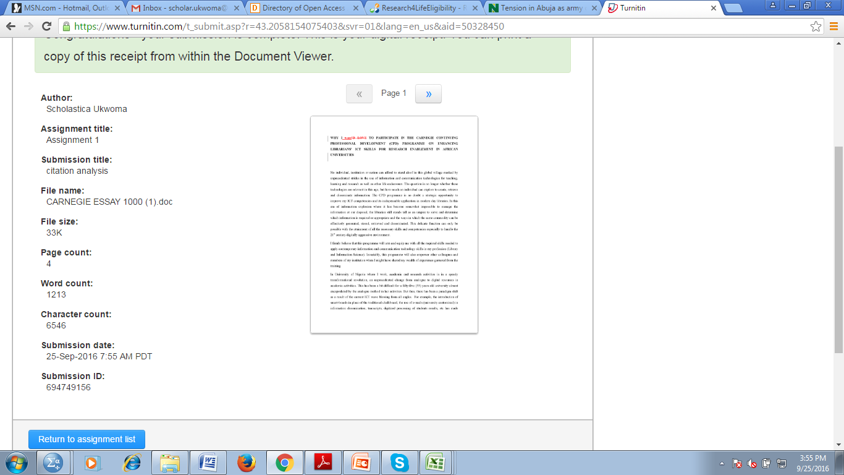
Click on “ Go to assignment inbox”

Slide 19
Keep refreshing your URL to get your result

Slide 20
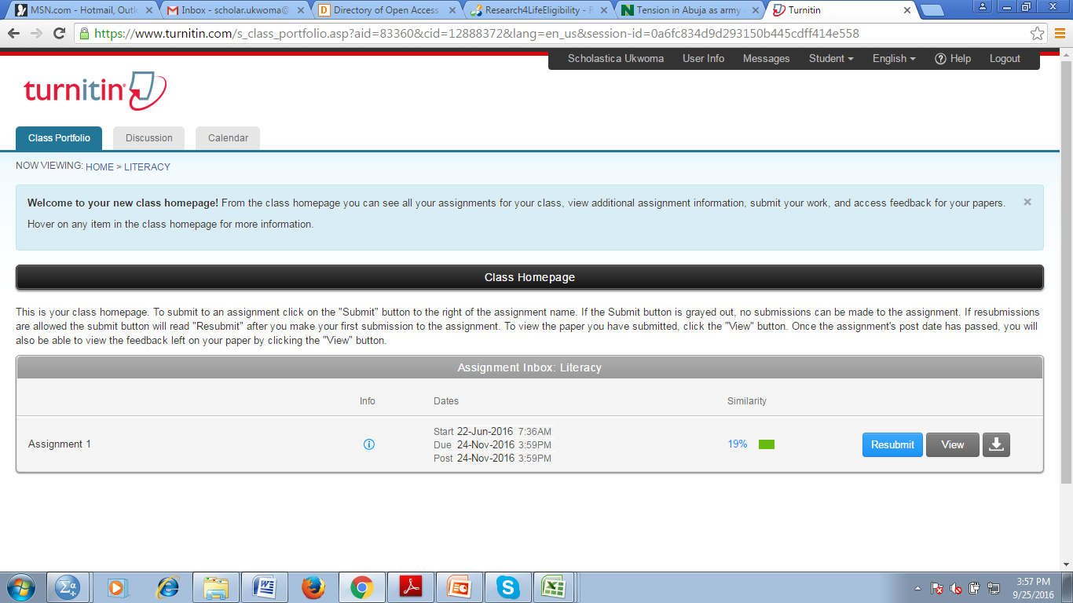
Once the result is out, click on the highlighted colour, it takes you to another page to see the originality report

Slide 21
Originality report from originality check

Slide 22
Originality report from originality check

Slide 23
You can resubmit again
The date due still allows to resubmit

Slide 24
Tips to avoid trouble
Never allow your settings to be in ‘Standard Repository’
Always set it in No Repository
Always copy out your Class and Paper/Submission IDs
Never delete your submissions
Always seek Admin help when you run into any challenge

Slide 25
Hands on Practical
Login
submit your assignment and check the similarity index
If it is high, rework it and submit again if you have the permission to resubmit.

