Slide 1
TRACKING RESEARCH OUTPUTS USING ORCiD
Training for University of Nigeria Staff

Slide 2
OBJECTIVE
For increased awareness and uptake of ORCiD identifiers among Staff of University of Nigeria, to enable them efficiently track their research activities and other institutional data outputs
To promote researcher visibility and other academic activities for improved access to local content

Slide 3
EXPECTED OUTCOMES
At the end of the training, participants will:
Gain hands-on experience with creating ORCiD Profile and importing of records

Slide 4
Matthew Buys - Regional Director, ORCID…Paper presented at WACREN Workshop, Abuja, 2016.

Slide 5
Book, Journal Article, Patent, a lecture etc

Slide 9
What is ORCID?
ORCiD means Open Researcher and Contributor ID is a nonproprietary alphanumeric code to uniquely identify scientific and other academic authors and contributors.

Slide 10
What ORCiD Does
ORCiD provides a persistent digital identifier that distinguishes you from every other researcher, through integration in key research workflows such as Manuscript and Grant submission,
Supports automated linkages between you and your professional activities ensuring that your work is recognized … http://qrcode.orcid.org/

Slide 13
WHY DO I NEED AN ORCID?
Having an ORCID allows you to better manage your research profile and keep it up-to-date.
Publishers, Funders and other Organizations are increasingly using ORCID in their Manuscript submission and Grant application procedures. Look at the list of current integrations

Slide 14
ORCiD Integrations
ORCiD is integrated with several systems and platforms such as; impactstory, Dataverse, ScienceOpen or manuscript submission or editorial sites (e.g. ScholarOne systems used by Emerald, Springer etc), Institutional repositories (such as Dspace), CRIS (Current research information systems) or RIMS (Research Information management systems) such as Elsevier's PURE, Clarivate's Converis and Symplectic Elements all allow or potentially allow you to login with your ORCID account.

Slide 15
Time to Register for your ORCID iD
Log on to: www.orcid.org

Slide 20
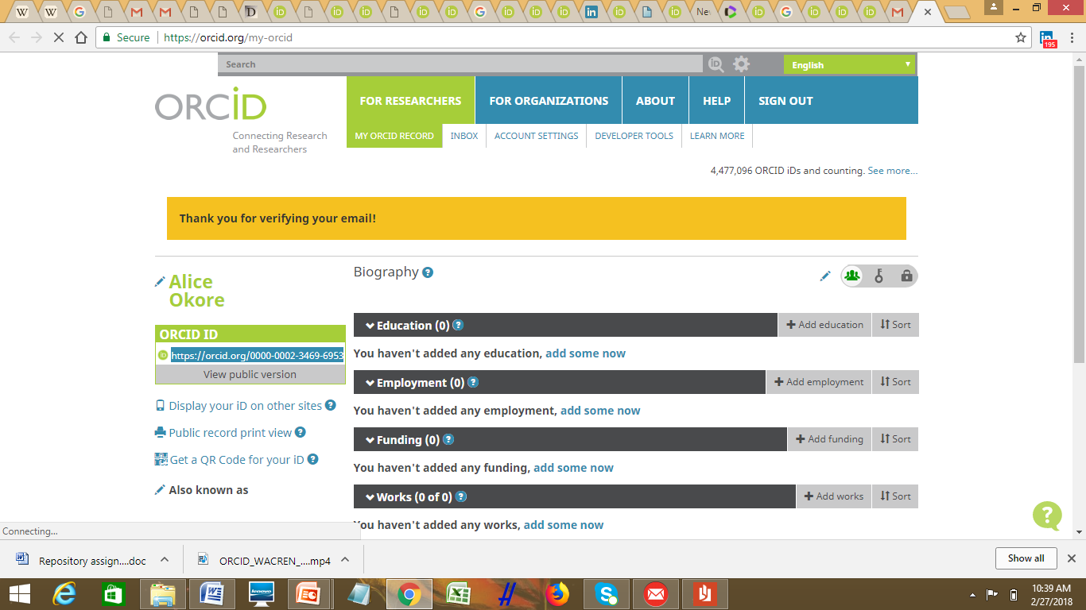

Slide 21
Now that you have registered, you need to do these things:
Add and edit your Personal information at the left pane of the webpage
Add your Education, Employment and Funding data
Add your Works

Slide 22
This is your ORCID id

Slide 24
Manually add your Biography, Education & Employment
Make your details public

Slide 25
Begin typing in the name of your institution, and you will be invited to select from a list.

Slide 26
Add Works
You can add works manually or by importing them from other scholarly sites where you have your publications eg. Google Scholar.
Importing your works into ORCiD
Click on the “Import Works” button on your main account page. Choose one of the Import Wizards on the page to get started.

Slide 27
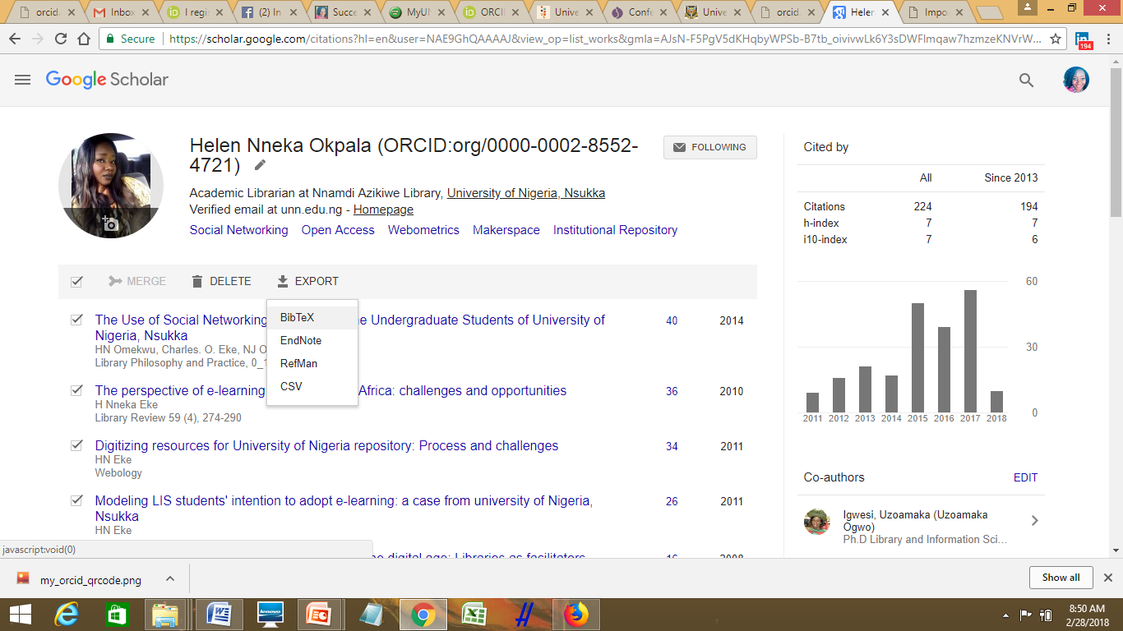
Exporting from GoogleScholar
Select the works to export or select ALL , then click on Export and click on BibTeX

Slide 28
Exporting from GoogleScholar Contd…
2
Once you click on Export, you will see a display in this format
1
You can select the second option if you wish to export all your articles. Then click on Export.
Right-click in an open space and select Save As
3

Slide 29
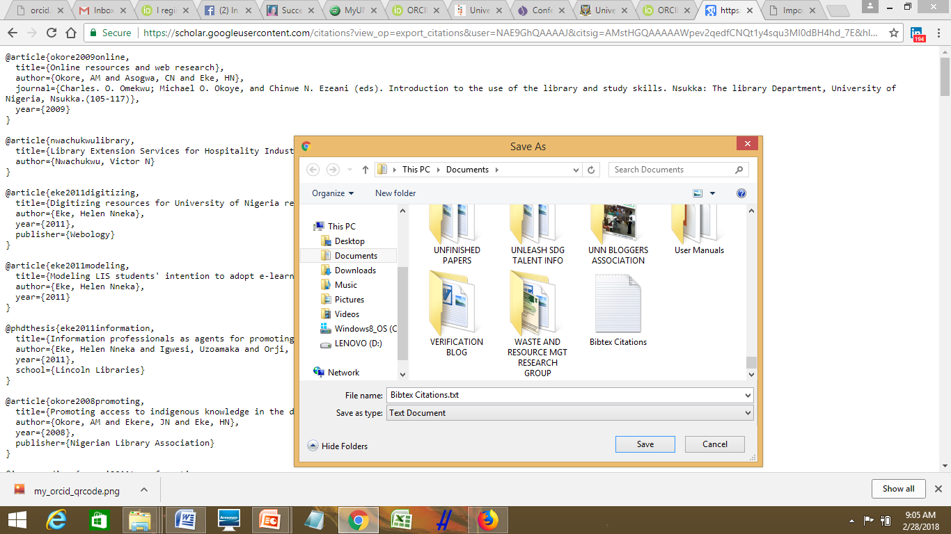
Saved BibTeX Citations

Slide 30
Click on Import BibTex
Note that you can manually edit these works after you have imported them, by clicking on Bulk Edit beside Export Works.

Slide 31
What is BibTex?
Source: https://en.wikipedia.org/wiki/BibTeX

Slide 32
To create your QR Code

Slide 33
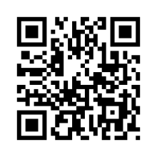
To Get a QR Code for your Site
NB:[QR Code stands for Quick Response Code] A QR Code is a machine-readable graphic that contains information, typically a website URL. Your ORCID iD QR Code is unique to you, and it represents your ORCID iD. Anyone who scans it with a QR Code reader such as a mobile phone, will be sent to your public ORCID record.
Download your ORCID iD QR Code and display it on posters, presentations, stickers, business cards -- anywhere you want your ORCID iD to be found.

Slide 35
Links to Referenced Works
https://indico.wacren.net/event/41/session/1/contribution/0/material/slides/0.pdf
https://orcid.org/blog/2013/12/05/i-claimed-my-orcid-id-now-what
https://en.wikipedia.org/wiki/BibTeX
http://www.scholar.google.com/
https://en.wikipedia.org/wiki/ORCID
: https://www.elsevier.com/connect/authors-update/ten-reasons-to-get-and-use-an-orcid-id!
www.orcid.org
https://wiki.duraspace.org/display/DSPACE/ORCID+Integration
https://wiki.duraspace.org/display/DSDOC5x/ORCID+Integration

Slide 36
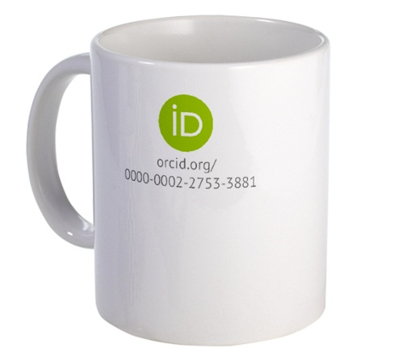
Thank you

