Slide 1
Moodle tutorial
By
DR. CHIELO IFEANYI CELESTINE
Chief Programmer
&
Head Webometrics Section
ICT Unit, UNN

Slide 2
introduction
Overview
Modular Object Oriented Distant Learning Environment (MOODLE) is a web application that can enable a teacher to prepare a course online or in a website and enable learners to access the course. In other words, MOODLE enables a teacher to extend a classroom to the internet. MOODLE is a typical examples of a Course Management System (CMS) or a Learning Management System (LMS) and every of such systems are web applications, they run on a server and are accessed through a web browser.

Slide 3
Instructional Objectives
By the end of this module, the students should be able to:
1.Log in to MOODLE
2. Create a course in MOODLE
3. Add users to the course
4. Add activities and/or resources to the course

Slide 4
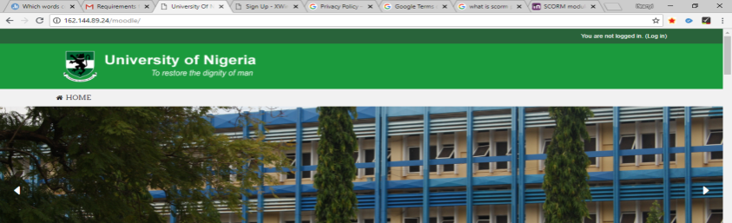
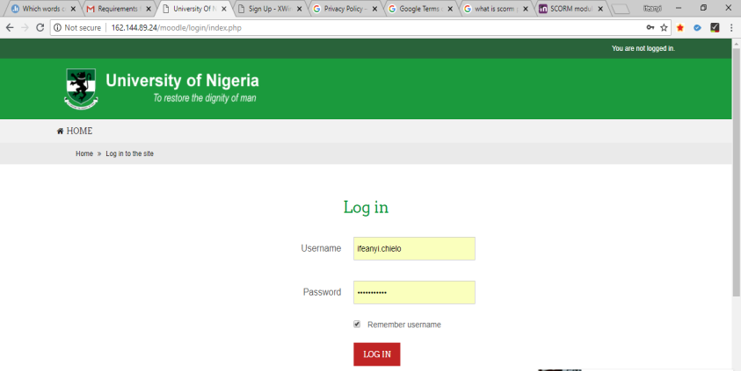
Logging into MOODLE
Logging into MOODLE simply means gaining access into MOODLE platform either as a instructor or as a learner. To do this, one have to follow the steps below.
Open a browser (Google chrome)
Enter the MOODLE web address in the
address bar and press enter
(eg. http://162.144.89.24/moodle/ )
Click log in at the top right hand corner
Enter your user name and your password and
Click login.
Click
Log in here

Slide 5
Creating a course
A Course is a tool in MOODLE that enables a
teacher to makes his or her learning material
available to learners. To create a course:
Click site administrator
Click courses
Click manage
Select sub categories (departments)
Click create new course

Slide 6
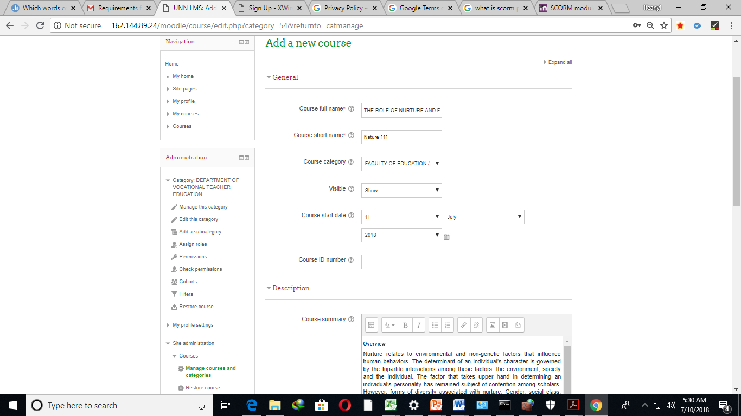
Enter module1 as full name
Overview and instr obj as desc

Slide 7
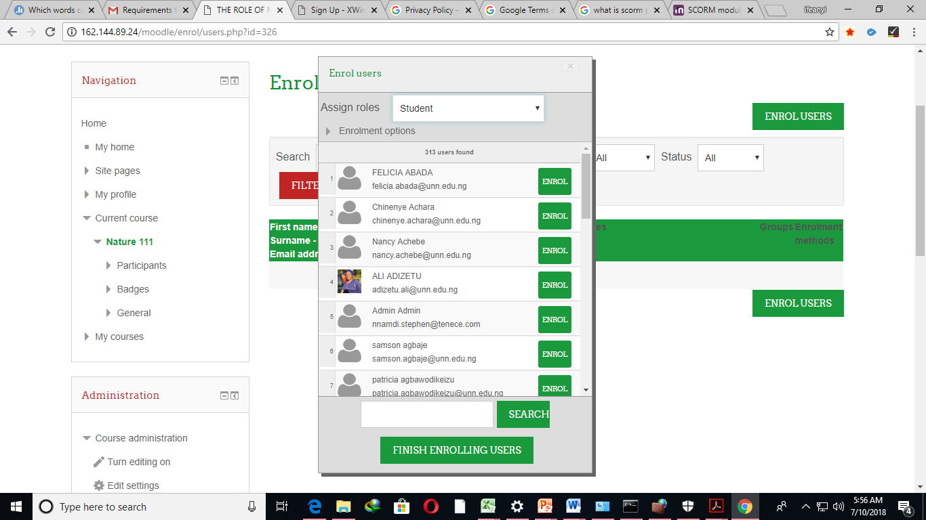
Enroll users
To enroll users to your course:
Click "Enroll users•
Select users to enroll
Click enroll
click Finish .
search
click
click
click

Slide 8
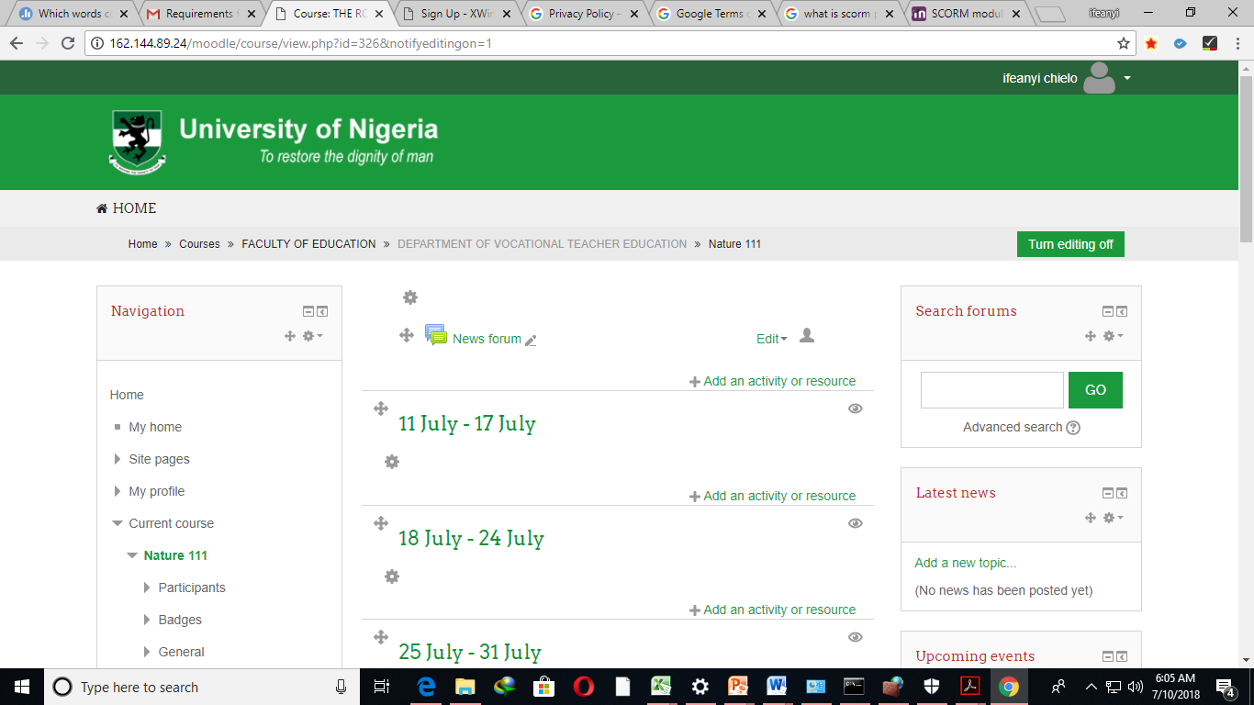
Add activities
Click Turn editing on
Click on add activities

Slide 9
Add activities
Select an activity
Click add

Slide 10
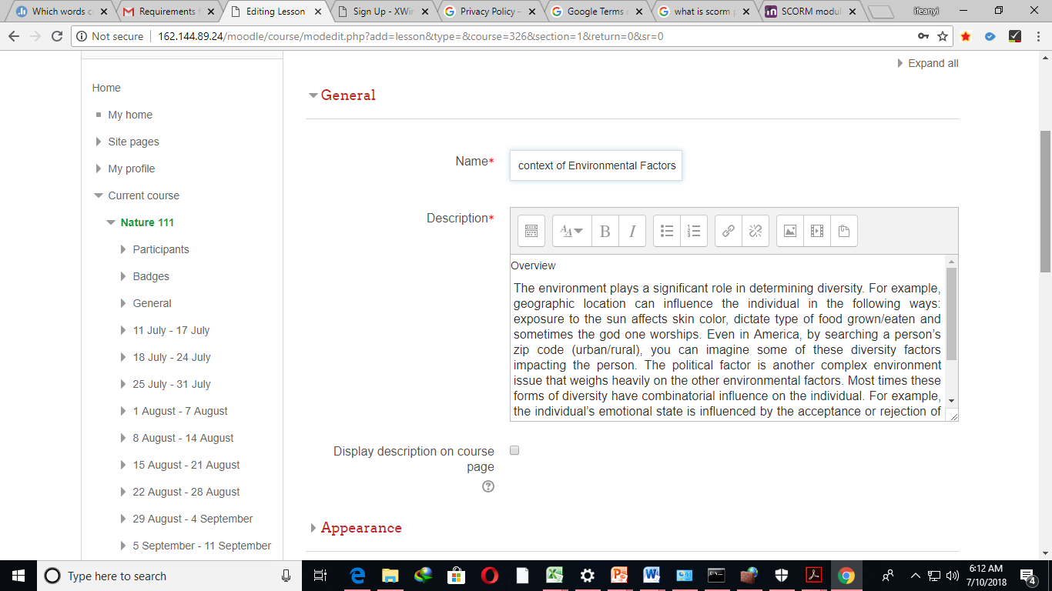
Pastte ur module sub title
Pastte the overview of the sub title

Slide 11
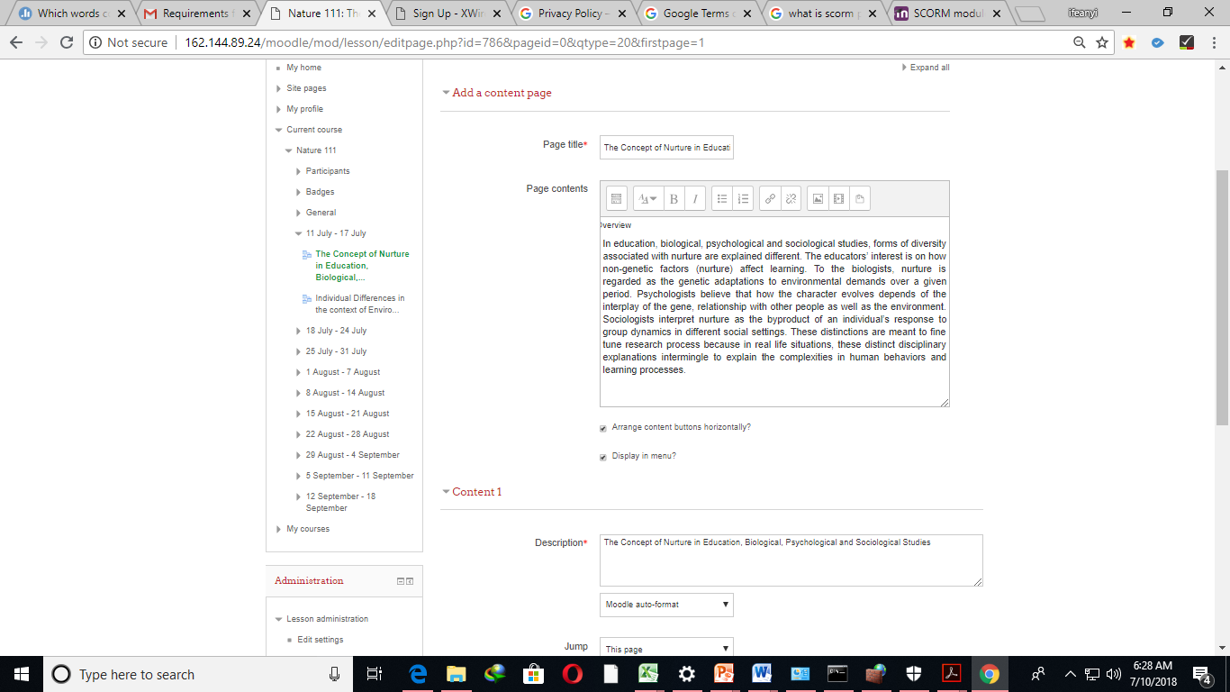
Add a content page for the added activity
Pastte ur module sub title
Pastte the overview of the sub title

Slide 12
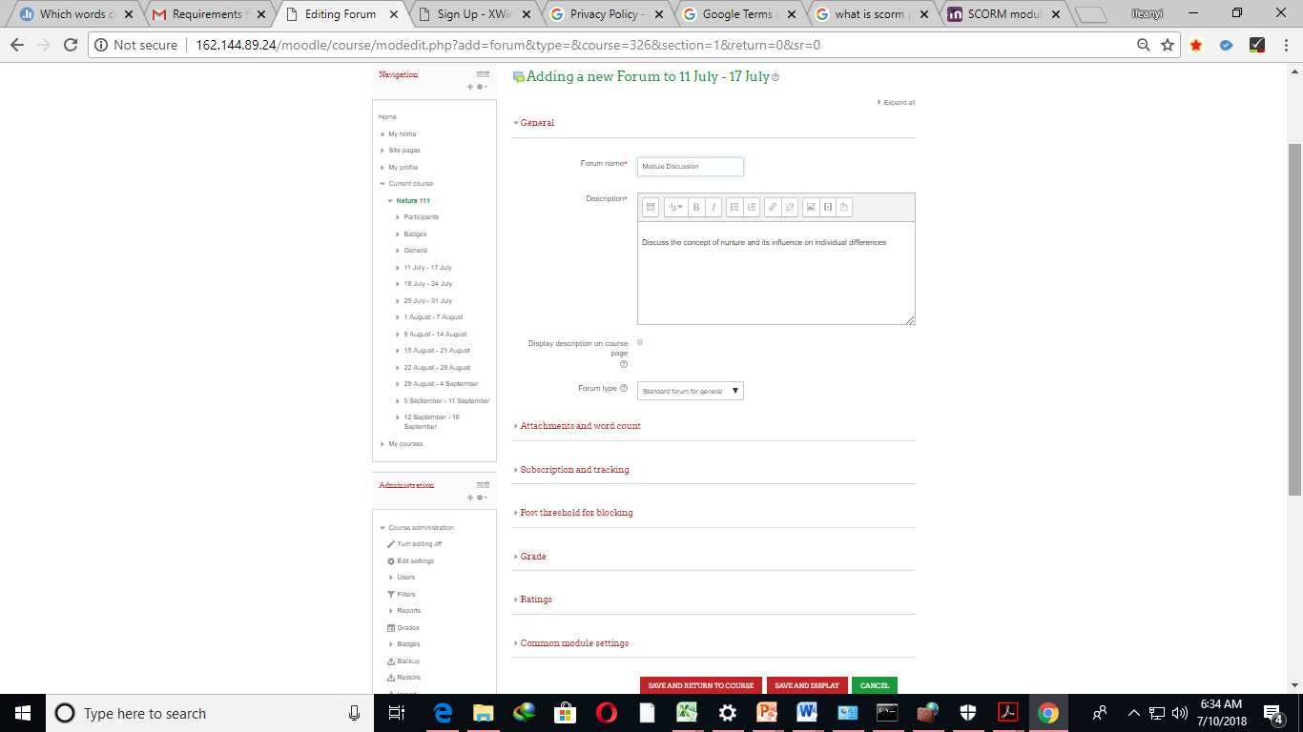
Follow steps in slide 8 and 9 to Add a forum as an activity
Pastte ur module discoursion

Slide 13
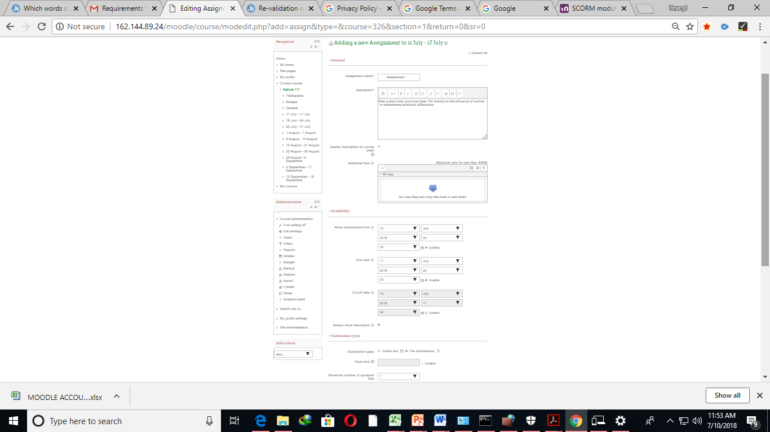
Follow steps in slide 8 and 9 to Add an assignment as an activity
Pastte ur assignment

Slide 14
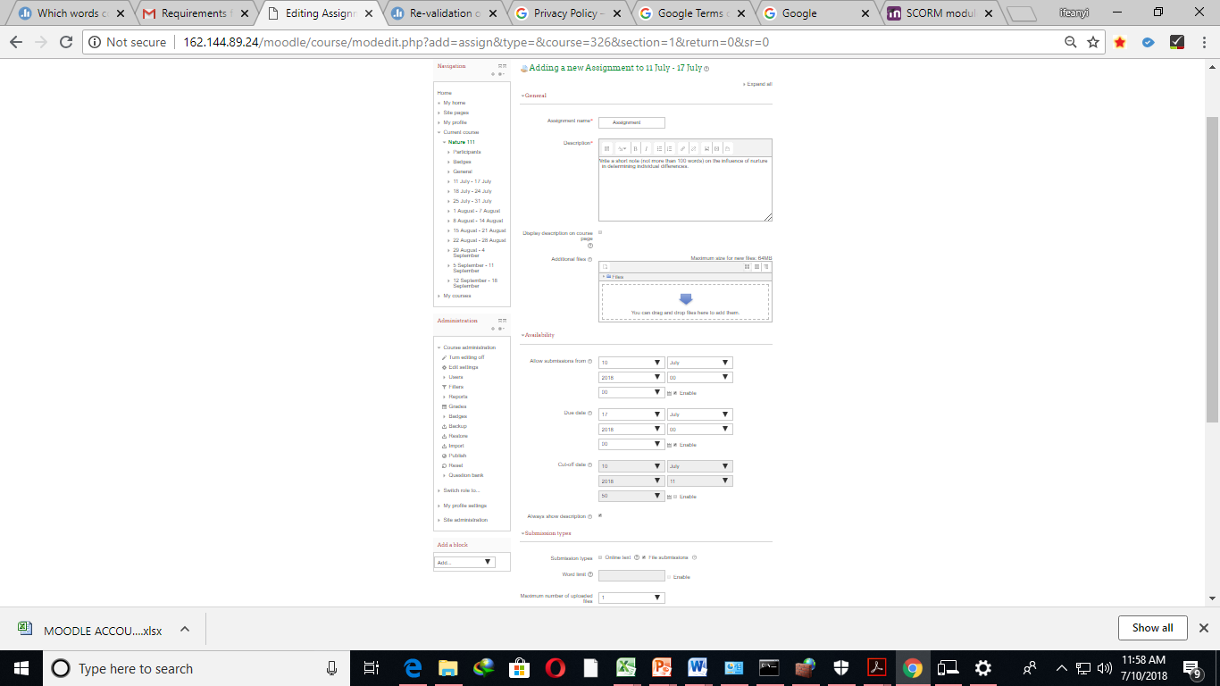
Follow steps in slide 8 and 9 to Add a quiz as an activity
Pastte ur module quiz
Add quiz

Slide 15
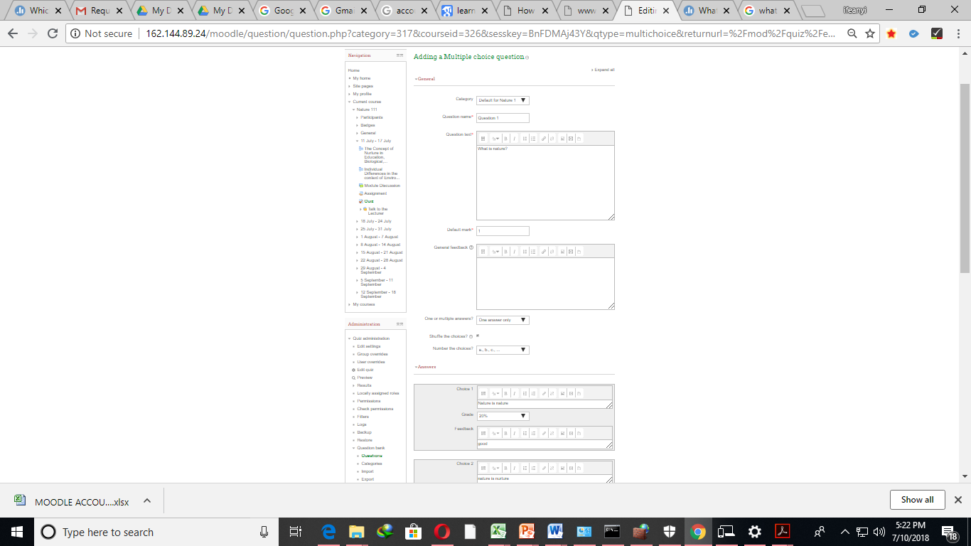
Add questions and answers

Slide 16
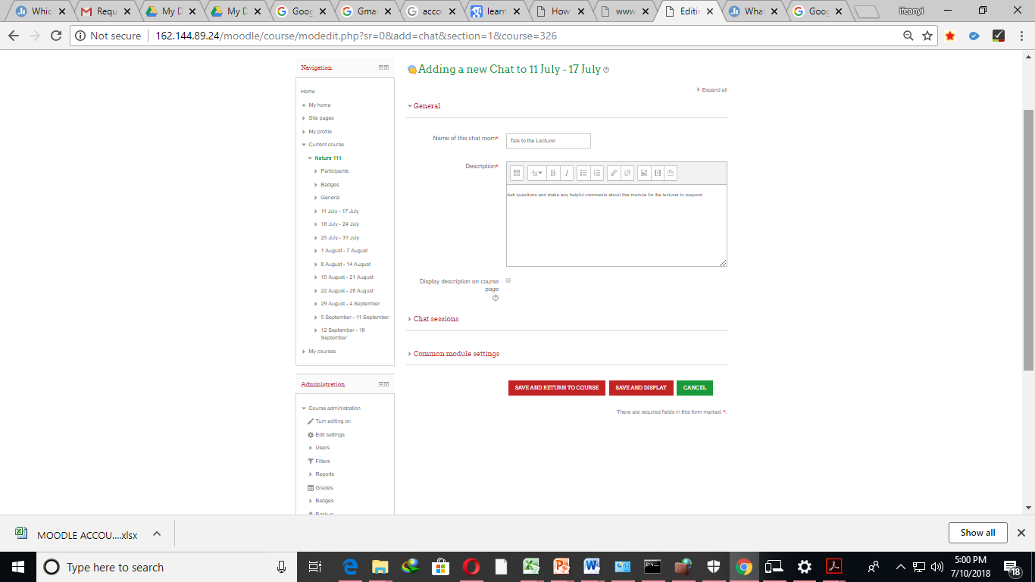
Pastte ur module discoursion
Follow steps in slide 8 and 9 to Add a chat as an activity

Slide 17
Step 11. Note that you can edit you profile photo to your choice.
THANKS

