Slide 1
MENDELEY
www.mendeley.com
UNIVERSITY OF NIGERIA,
NSUKKA
Topic: Online Reference Management Tools in the Digital Era: Introduction to Mendeley
By
Dr E.C. Ihekwoaba
emmanuel.ihekwoaba@unn.edu.ng
Notes:
We support academics, students and other professionals (or researchers) in their work with scientific literature.
We provide scientific knowledge.
We organize scientific knowledge.
We help to explore and share scientific knowledge.

Slide 2
OUTLINE
What is Mendeley?
Creating your Mendeley Account
Downloading Mendeley Desktop
Installing Mendeley Desktop
Configuring your Mendeley Application
Building your Library
Managing the documents in your Library
Inserting Citation
Inserting Bibliography

Slide 3
GOALS AND OBJECTIVES
At the end of this presentation;
Students would know what Mendeley online reference tool manager is all about
Students would be able to use the Mendeley online reference tool manager to do their citation and referencing

Slide 4
What is Mendeley?
Mendeley is a free academic software used to manage, read, annotate and cite your research papers.
It is a reference manager.

Slide 5
Mendeley is based in London, and was developed by over 30 researchers, graduates and software developers. It is backed by co-founders and former executives of:
...and Supported by:

Slide 6
Things you could do with Mendeley
Add and Organize - Import and organize PDFs from your Computer and other storage devices.
Back up and Sync your resources - Access your papers anywhere, on other Computers or even your smart devices.
Reference Manager - Generate citations and bibliographies in Microsoft Word, and other word processing applications.

Slide 7
STEP 1
Create your Mendeley Web Account
in
www.mendeley.com

Slide 8
Log into www.mendeley.com to create your free Account (Fill out the Form)
Email
First Name
Last Name
Password
Fill out the Form

Slide 9
(Complete the Online Form)
Field of Study
Enter current Institution
Academic Status
Save and continue
Create Account

Slide 10
Mendeley Web Account Interface

Slide 11
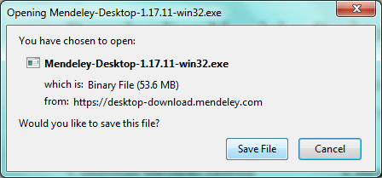
STEP 2 Download the Mendeley Desktop Software Application from www.mendeley.com Click on ‘Save File’ to download Mendeley Desktop Software

Slide 12
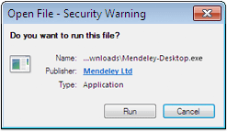
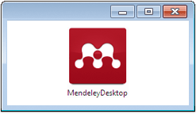
STEP 3 Install Mendeley Desktop and sign into your Account.
1. Click on ‘Run’ to Install Mendeley Desktop
2. Click to open Mendeley Desktop and sign into your Account

Slide 13
STEP 4 Configure your Mendeley Desktop Application Software
1.Install MS Word Plugin – This enables your word document processor and Mendeley to communicate and work together in the citation process
2. Install Web Importer – This enables Mendeley grab citation off the web

Slide 14
How to confirm that the MS Word Plugin is installed

Slide 15
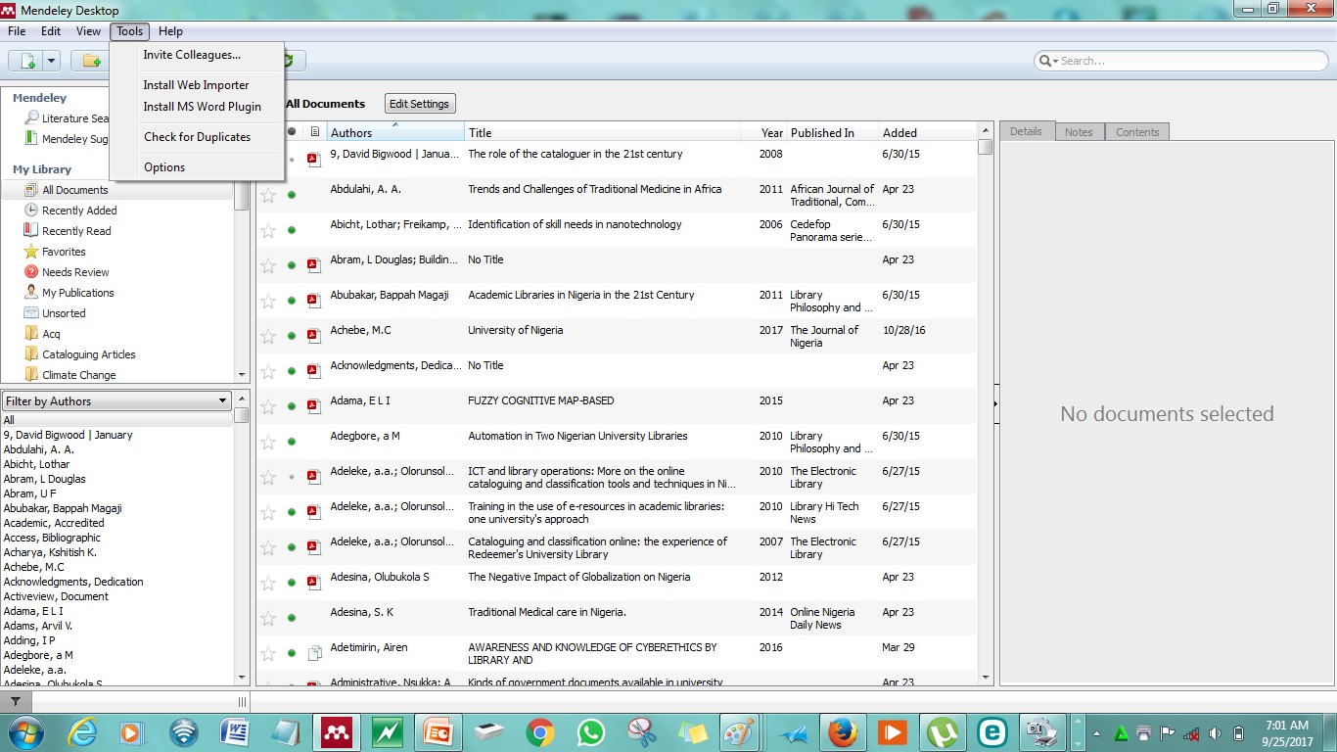
(Configuration) Installing Web Importer and MS Word Plugin
1.The Web Importer helps you grab documents off the web.
2.The MS Word Plugin helps Mendeley to work with your Word Processor

Slide 16
STEP 5
Build your library
Before you start writing, you must have a well built Library in Mendeley where you can pick the citations to support your write-up and Bibliography to show documents cited.

Slide 17
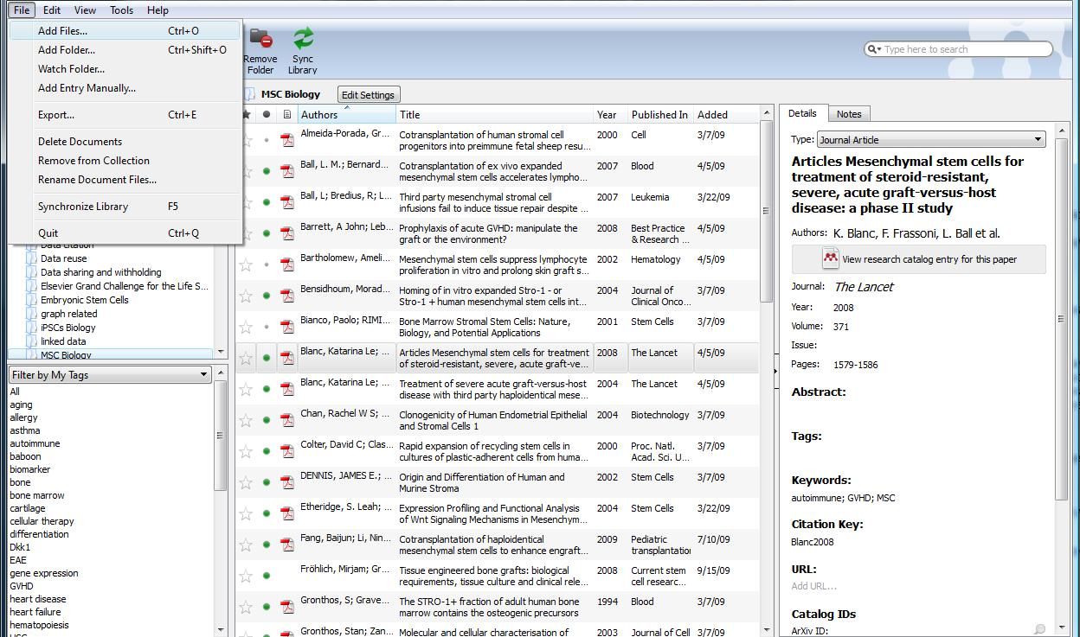
Building your library means adding documents to your Mendeley Desktop Application
You have 4 different options for building your library:
Through documents in your computer
Through documents in your external storage device, eg, Flash drive, hard drive, CD or DVD
Through the Web using Web Importer
Through manual method

Slide 18
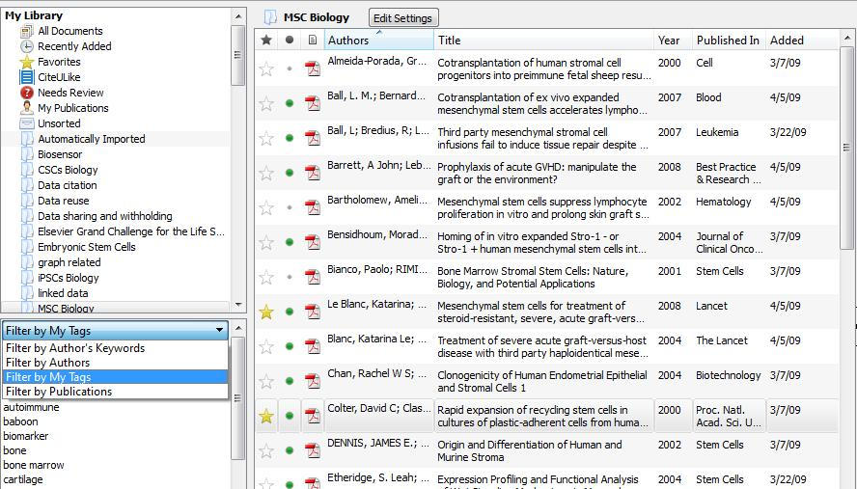
Managing the Documents in your Library
Documents can be marked read/unread
Star your favorite papers
Filter by authors, tags, publications or keywords

Slide 19
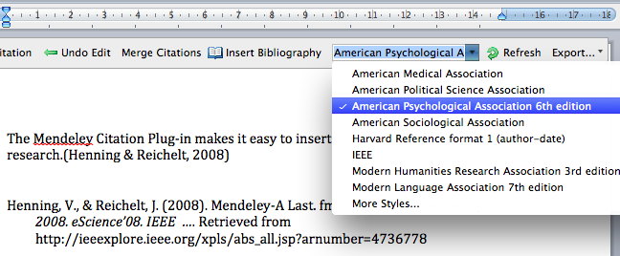
STEP 6
Inserting Citation
Citation will show up based on selected style

Slide 20
1. ‘Click on ‘Insert Citation’ then; 2. Click on ‘Go to Mendeley’ to insert in-text citations
1
1
2
2

Slide 21
Merging Citations and Adding Multiple Citations
If two separate citations appear together you may want to combine these into a single reference for style purposes.
Simply highlight the two references you need to merge and press the ‘Merge Citations’ button on the toolbar.
The two citations will be merged into a single, properly styled reference.
You can also add multiple citations when inserting citations. Instead of pressing ‘Ok’ after identifying a source in the Citation Editor, simply search for a second source to reference using the same interface.
Once you’ve selected the desired second item, press ‘Ok’ to add both items as a single, merged reference.

Slide 22
STEP 7 Inserting Bibliography Click on ‘Insert Bibliography’ to insert cited works
*

Slide 23
Thank you for listening
MENDELEY
www.mendeley.com
Emmanuel Chukwudi Ihekwoaba, Ph.D
emmanuel.ihekwoaba@unn.edu.ng
08080260062 – WhatsApp
08038814838 – Voice Call

