Slide 1
edublogs
EASY BLOGGING FOR EDUCATION
POWERED BY ict webometrics, unn

Slide 2
What is Edublog
An edublog is a blog created for educational purposes. Edublogs archive and support student and teacher learning by facilitating reflection, questioning by self and others, collaboration and by providing contexts for engaging in higher-order thinking.

Slide 3
How to create Edublog
There are no limits on the number of blogs you can create.
Please refer to sign up and register

Slide 4
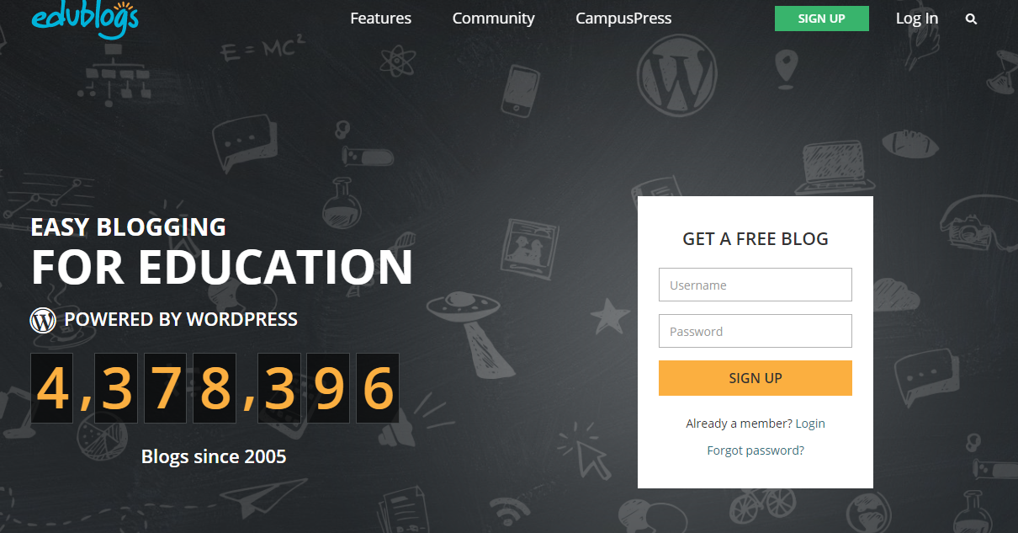
Sign Up /Login Access

Slide 5
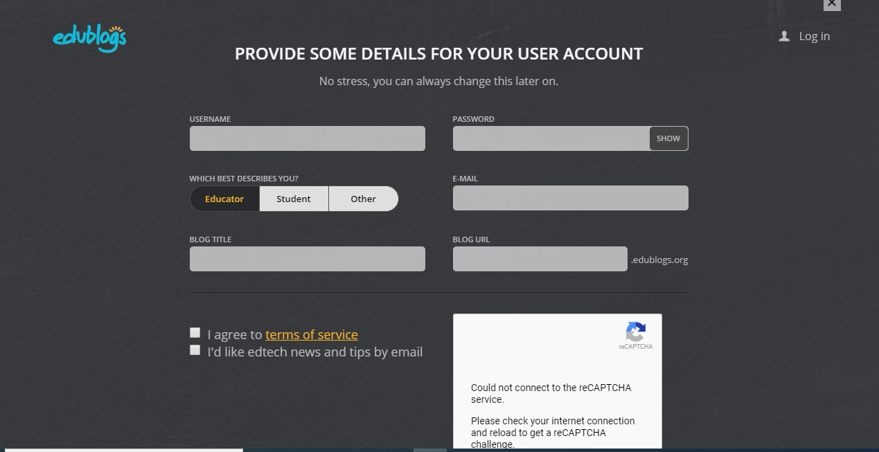
Registration

Slide 6
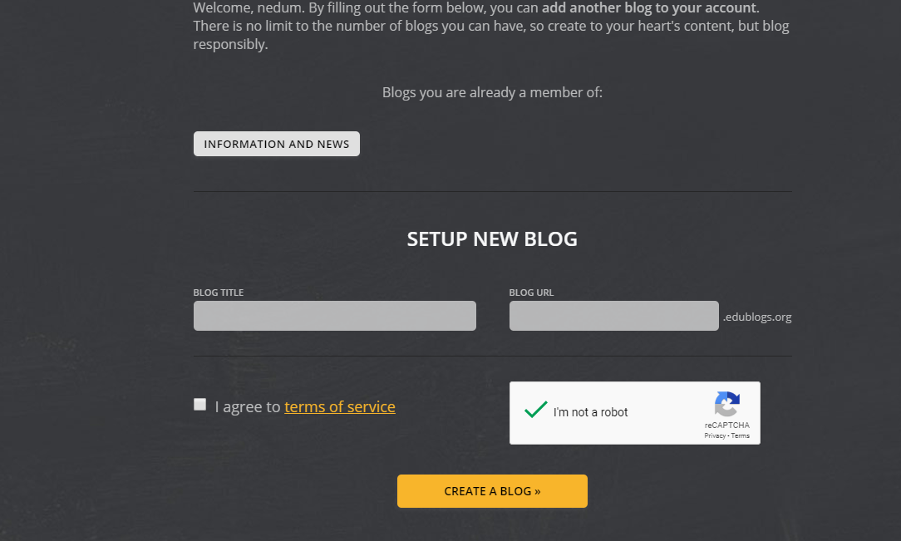
logging in

Slide 7
Create Blog
Your URL will be sent to your email after registration for confirmation

Slide 8
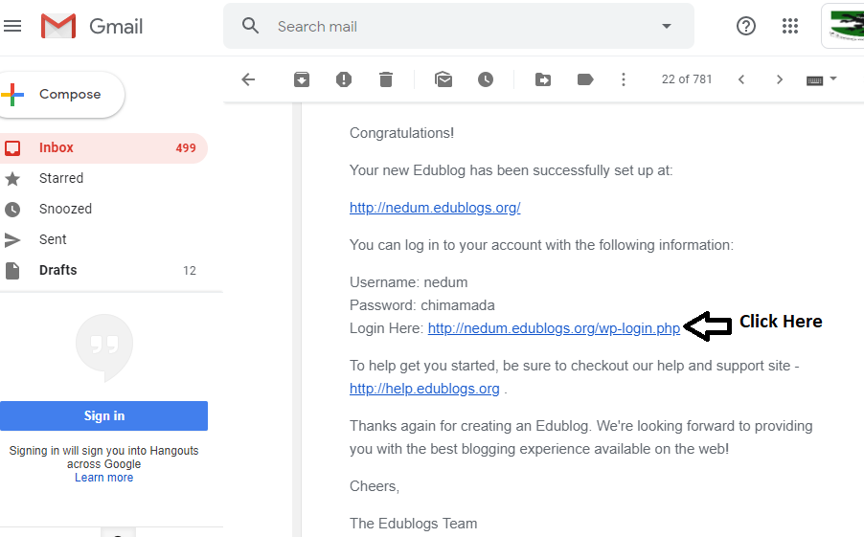
Logging in Activation

Slide 9
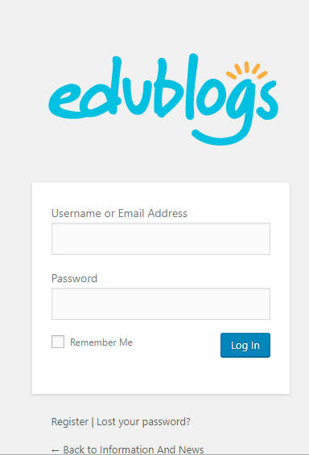
Login Details

Slide 10
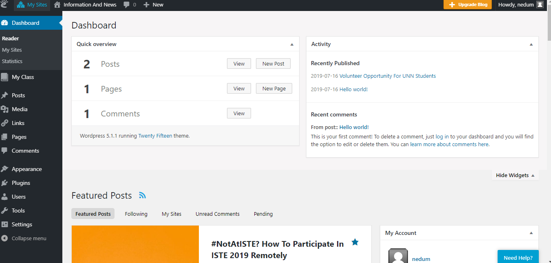
Dashboard

Slide 11
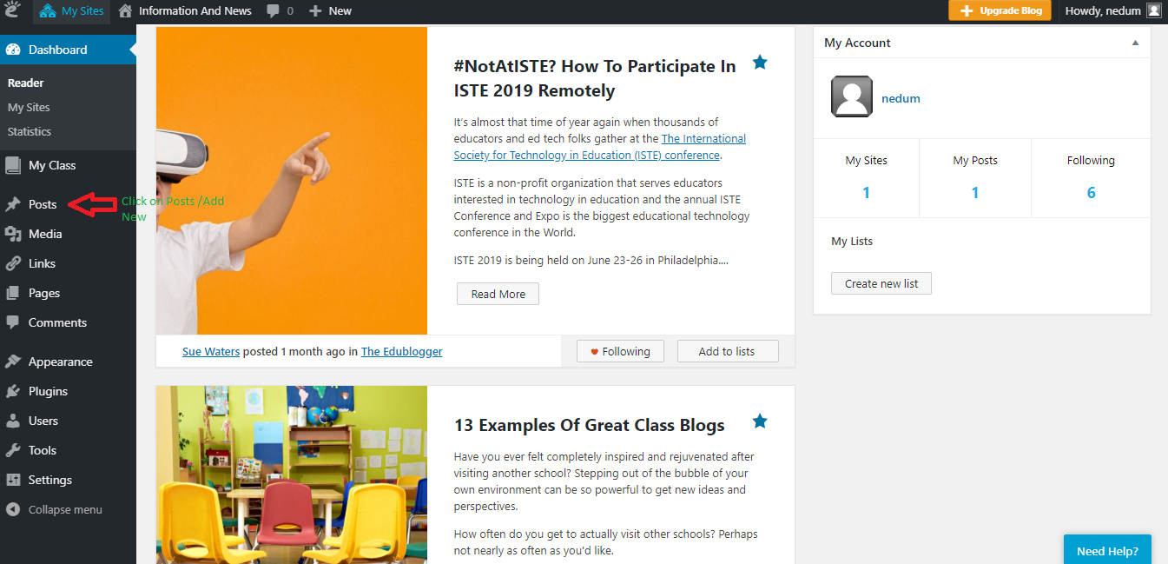
Highlight Post /Click Add new

Slide 12
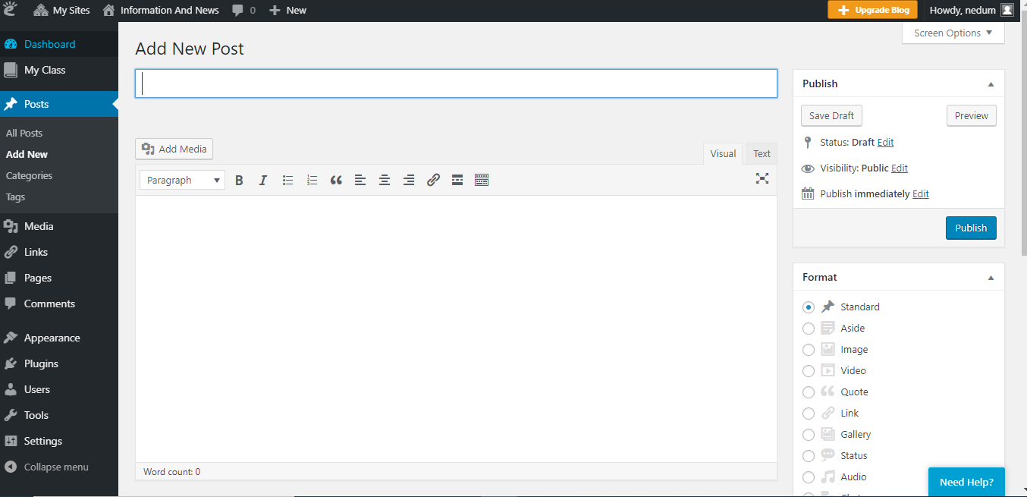
Add new post

Slide 13
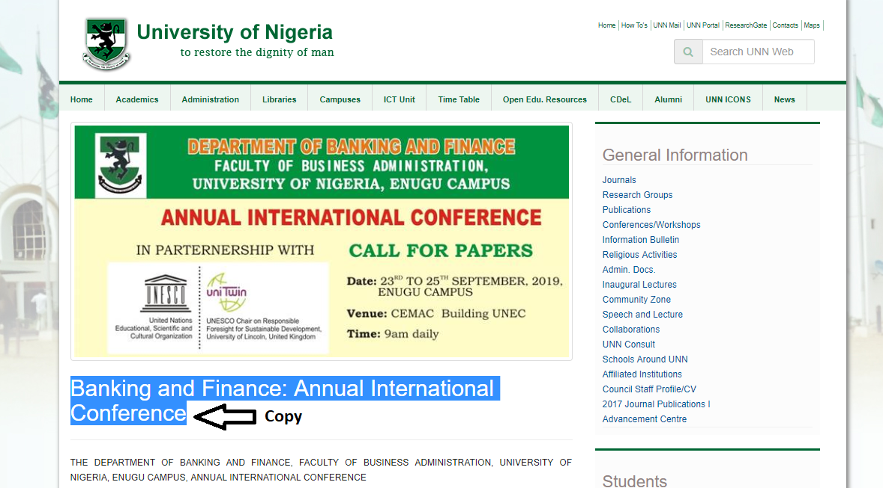
Go to UNN-Website

Slide 14
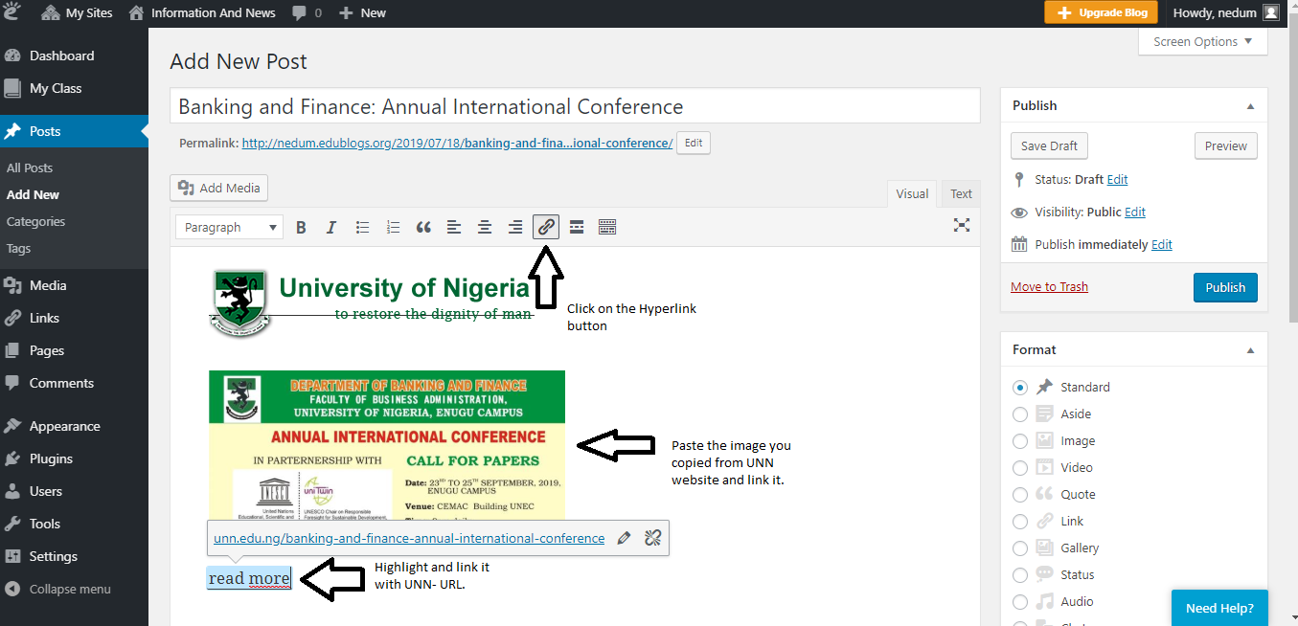
How to post and link

Slide 15
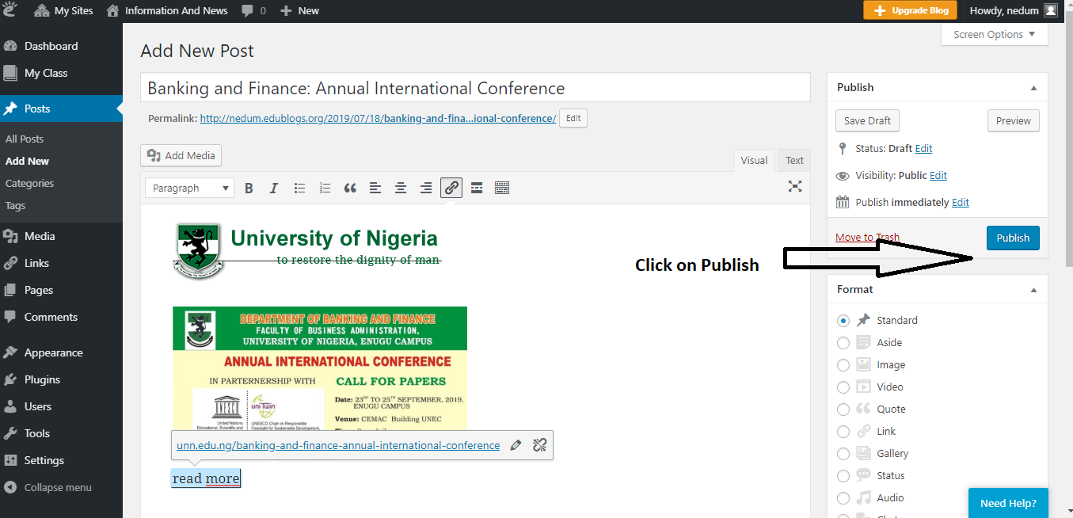
Publish your post

Slide 16
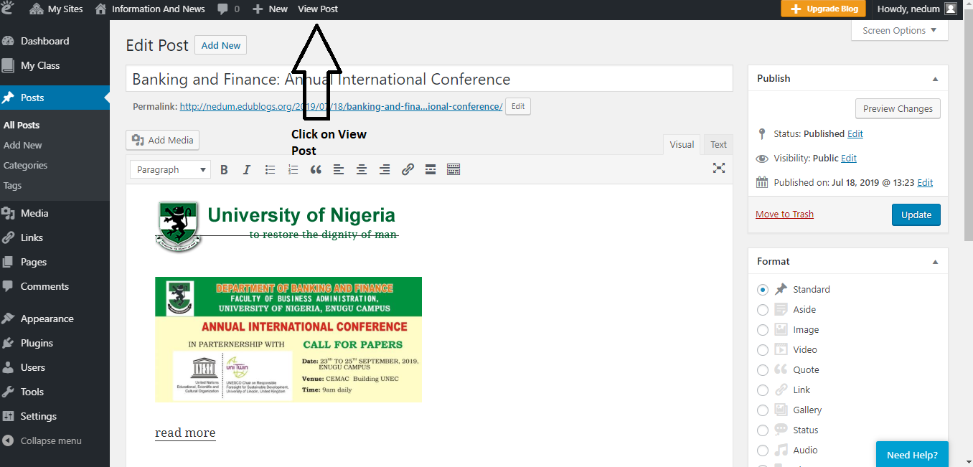
To view your post

Slide 17
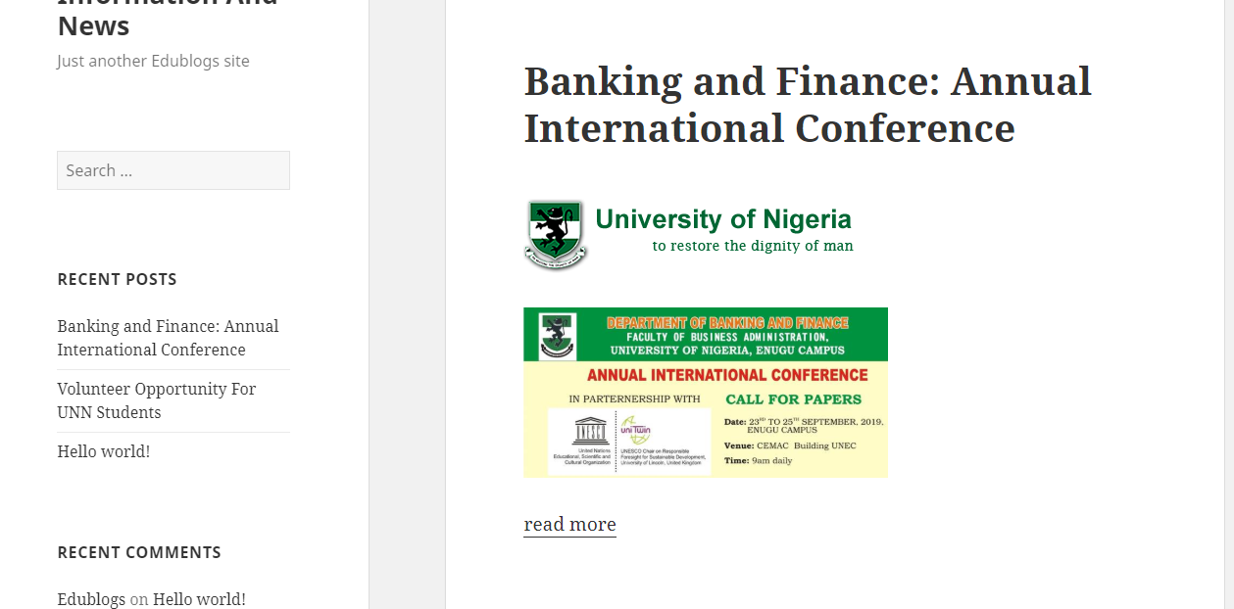
Post viewed

