Slide 1

s

Slide 2

SDGs
SUSTAINABLE DEVELOPMENT GOALS
BY
PARGITE
BRIGHT UGOCHUKWU
MGBEMELE

Slide 3
DEFINITION OF TERMS
SUSTAINABLE
DEVELOPMENT
GOALS

Slide 4
Sustainable development is development that meets the needs of the present without compromising the ability of future generations to meet their own needs.

Slide 5
TRANSFORMING OUR WORLD: THE 2030 AGENDA FOR SUSTAINABLE DEVELOPMENT
The United Nations secretary – General Ban ki-moon said that “we do not have plan B because there is no planet B”
Paragraph 54 United Nations Resolutions A/RES/70/1 of 25 September 2015
Resolution A/RES/66/288 (The Future we want)
The Intergovernmental Negotiations on the Post 2015 Development Agenda.

Slide 6
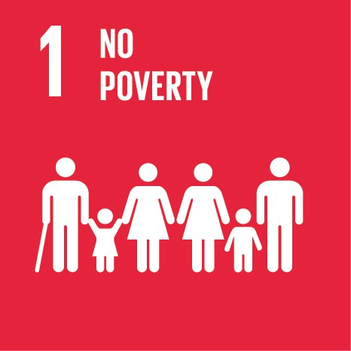
THE GLOBAL GOALS
FOR SUSTAINABLE DEVELOPMENT
END POVERTY IN ALL ITS FORMS EVERYWHERE

Slide 7
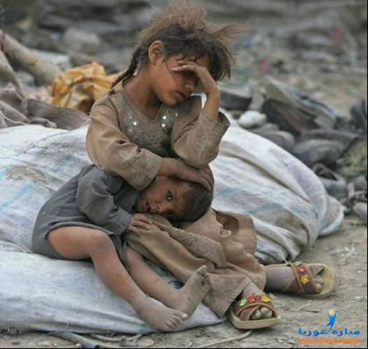
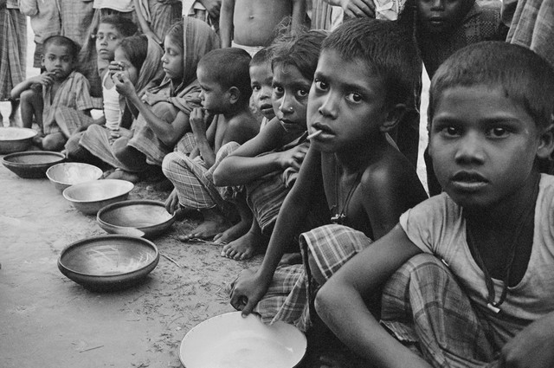

Slide 8
Poverty is more than lack of income or resources – it includes lack of basic services, such as education, hunger.
Eradicating poverty in all its forms remains one of the greatest challenges facing humanity. While the number of people living in extreme poverty dropped by more than half between 1990 and 2015 – from 1.9 billion to 836 million – too many are still struggling for the most basic human needs.

Slide 9
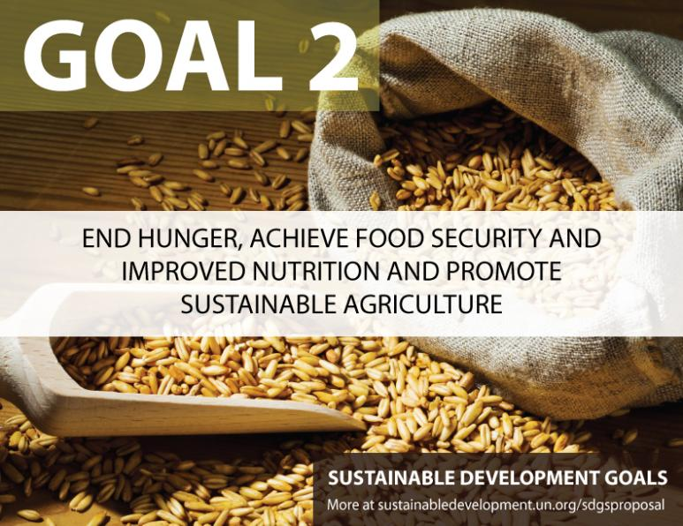

Slide 10
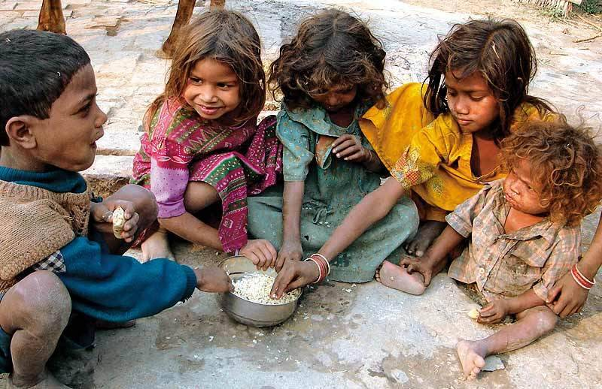
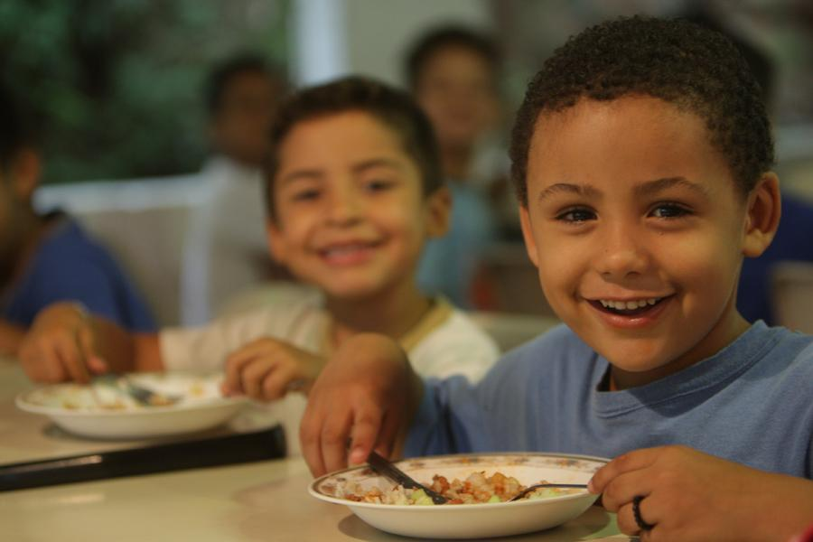
244,000 CHILDREN IN BORNO
4.4 MILLION

Slide 11
Globally, one in nine people in the world today (795 million) are undernourished. (2014)
Poor nutrition causes nearly half (45 per cent) of deaths in children under five – 3.1 million children each year.
One in four of the world’s children suffer stunted growth.
66 million primary school-age children attend classes hungry across the developing world, with 23 million in Africa alone.
Over 90 million children under the age of five are dangerously underweight.

Slide 12

THE GLOBAL GOALS
FOR SUSTAINABLE DEVELOPMENT
ENSURE HEALTHY LIVES AND PROMOTE WELLBEING FOR ALL AT ALL AGES

Slide 13

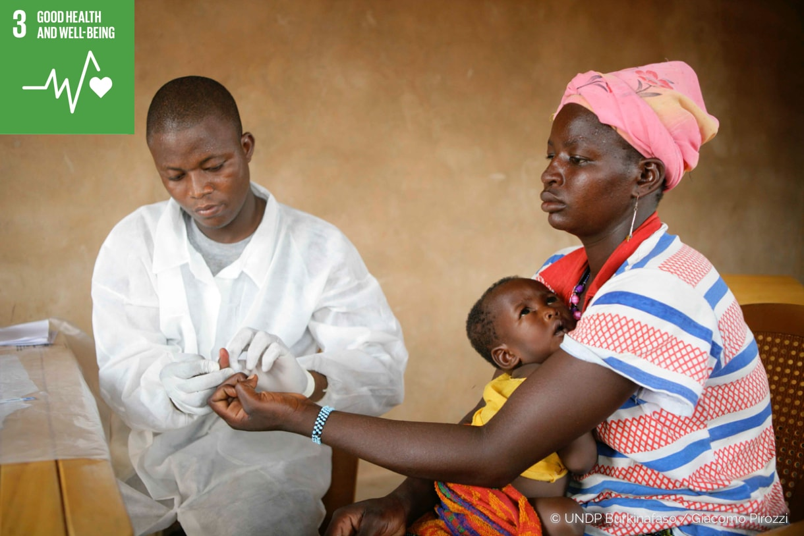
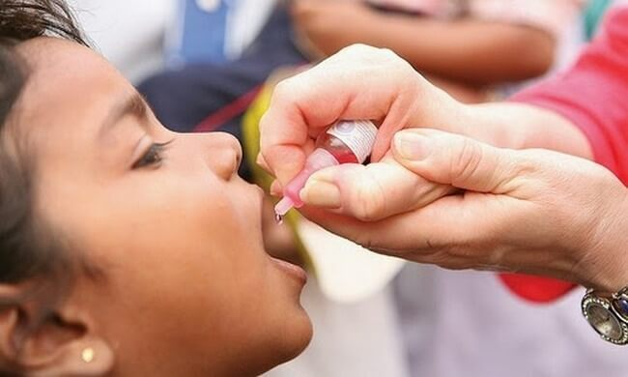

Slide 14

THE GLOBAL GOALS
FOR SUSTAINABLE DEVELOPMENT
ENSURE INCLUSIVE AND EQUITABLE QUALITY EDUCATION

Slide 15
Education is one of the most powerful and proven vehicles for sustainable development.
This goal ensures that all girls and boys complete free primary and secondary schooling by 2030.
It also aims to provide equal access to affordable vocational training, to eliminate gender and wealth disparities, and achieve universal access to a quality higher education.

Slide 16
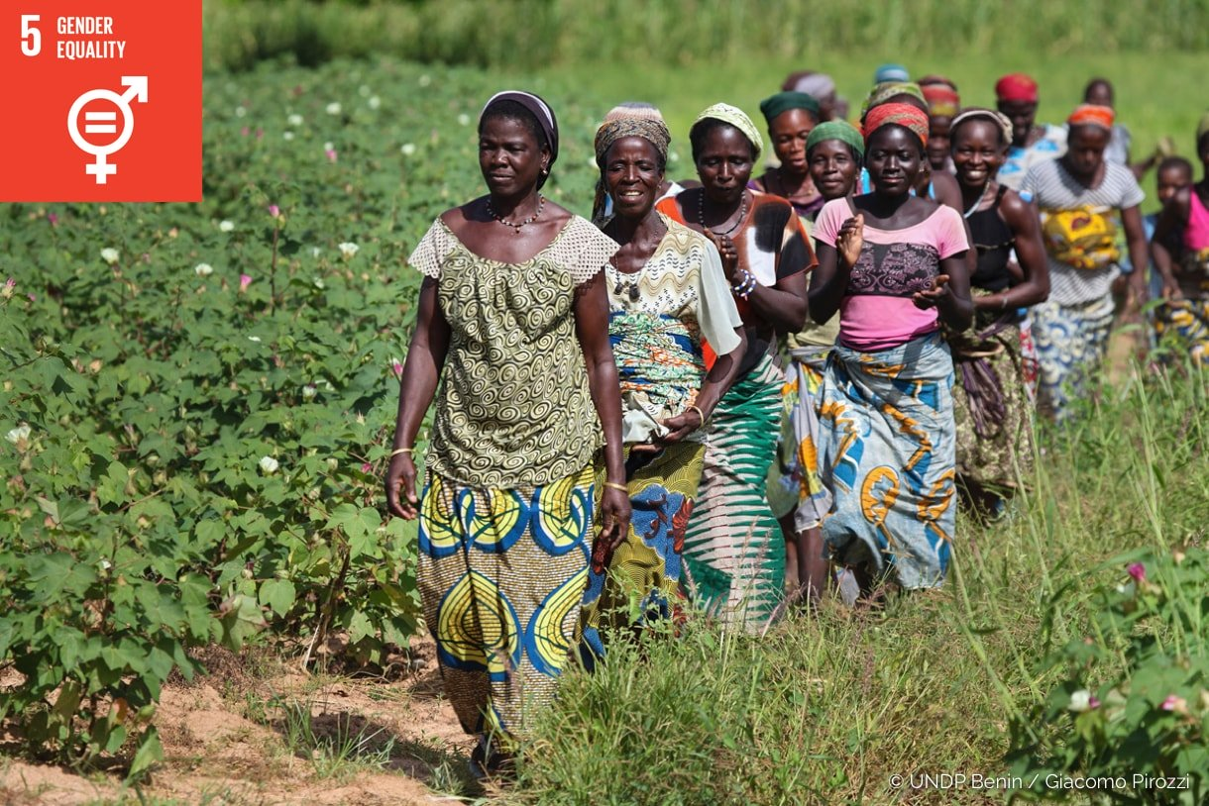

Slide 17
Ending all forms of discrimination against women and girls is not only a basic human right, but it also crucial to accelerating sustainable development. It has been proven time and again, that empowering women and girls has a multiplier effect, and helps drive up economic growth and development across the board.

Slide 18

THE GLOBAL GOALS
FOR SUSTAINABLE DEVELOPMENT
ENSURE AVIALABILITY AND SUSTAINABLE MANAGEMENT OF WATER AND SANITATION FOR ALL

Slide 19
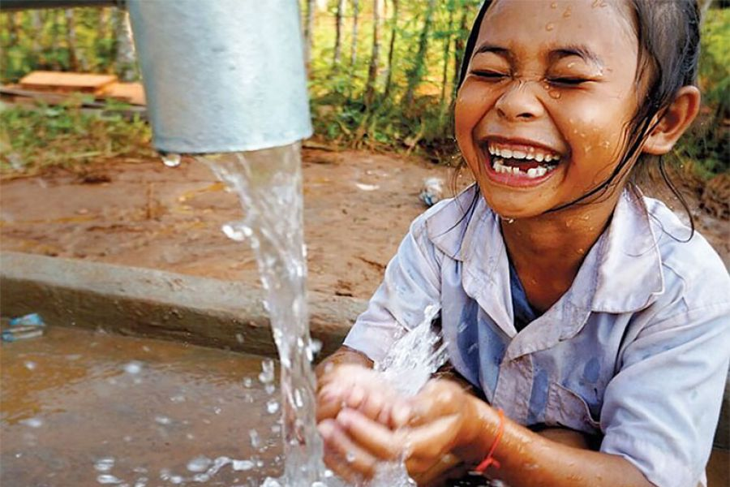
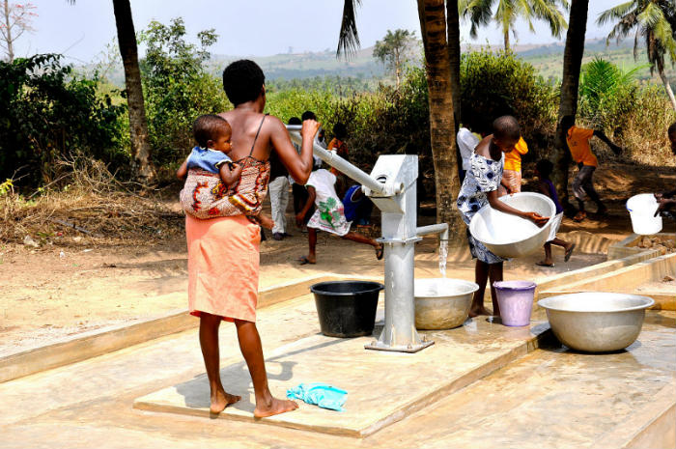
57mil
60000
Wateraid.org

Slide 20
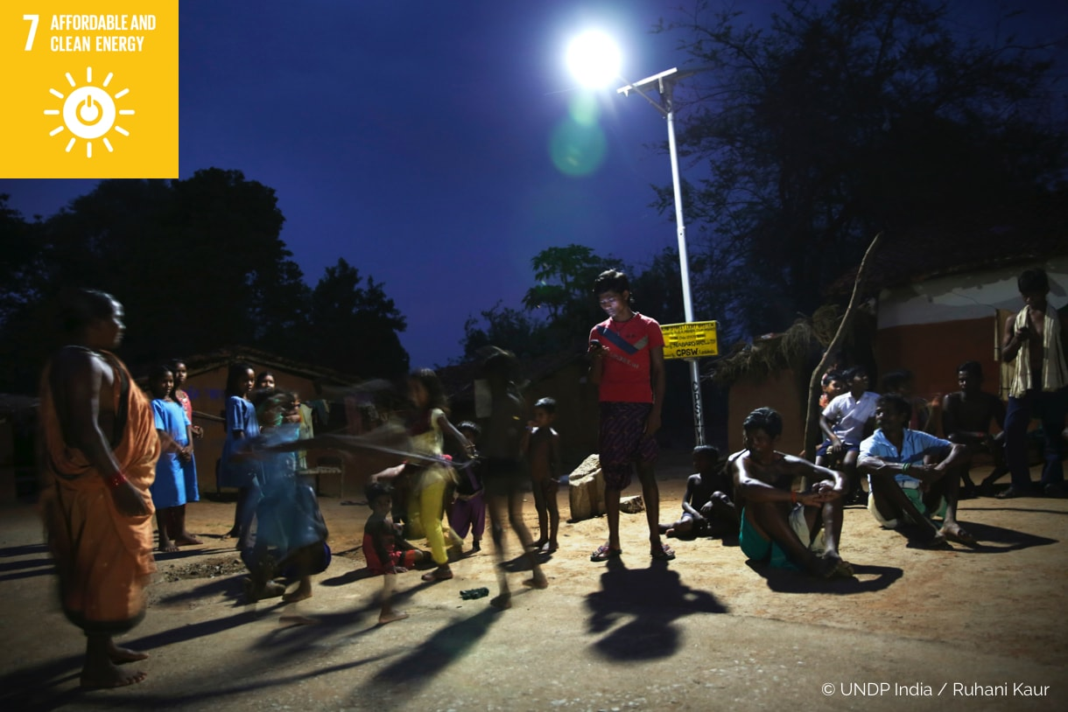
ENSURE UNIVERSAL ACCESS TO AFFORDABLE, RELIABLE AND MODERN ENERGY SERVICES

Slide 21
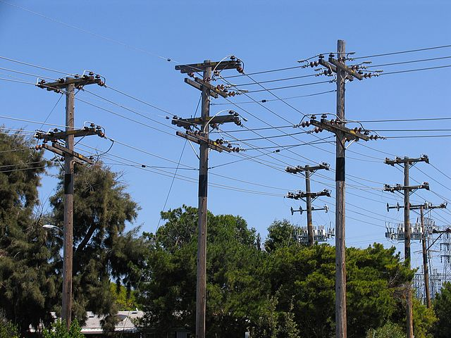
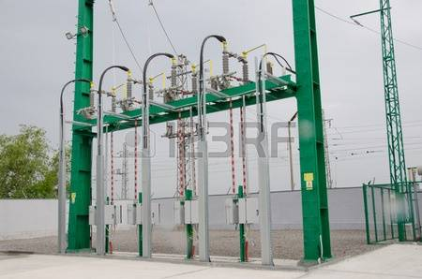
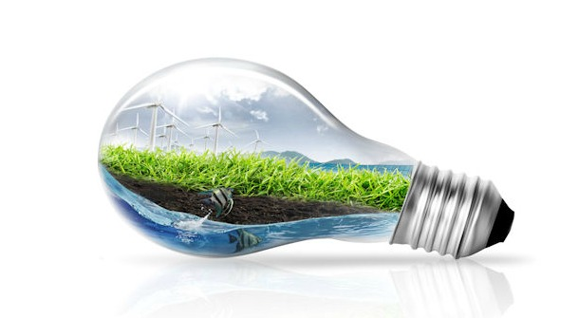
75 Million

Slide 22

THE GLOBAL GOALS
FOR SUSTAINABLE DEVELOPMENT
ENSURE FULL AND PRODUCTIVE EMPLOYMENT AND DECENT WORK

Slide 23
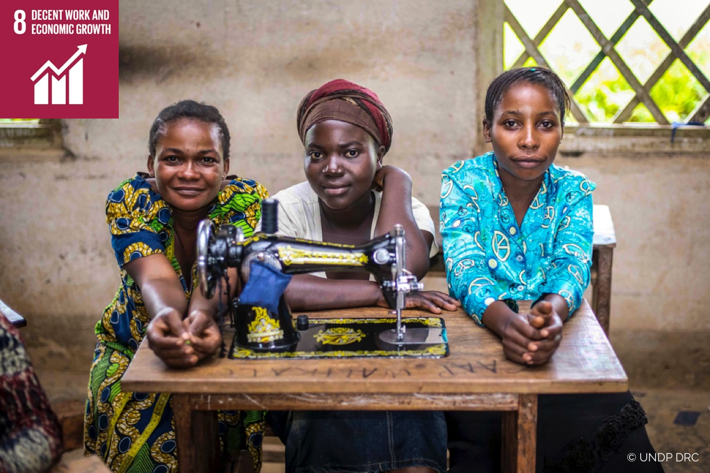

Slide 24
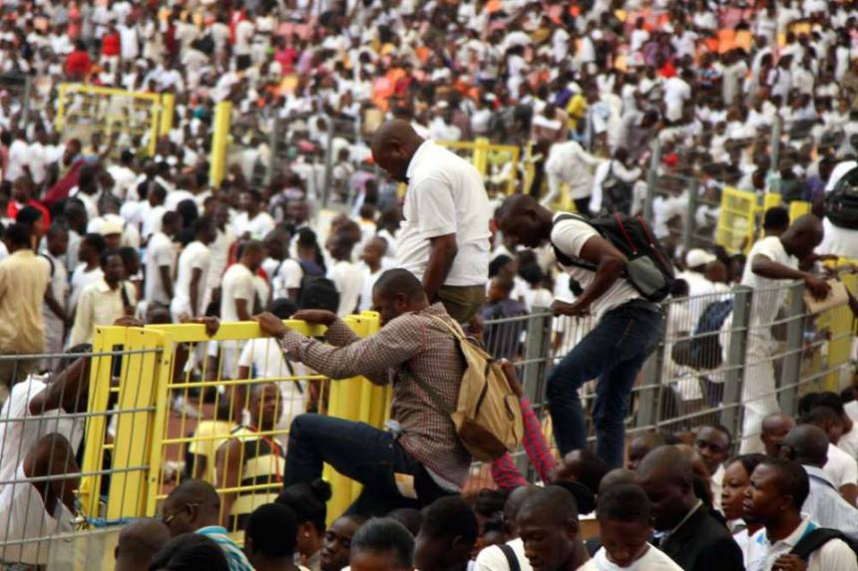

Slide 25
Unemployment Rate Rose To 14.2% In The 4th Quarter Of 2016 According To Nbs.
Premium Times Wed June 7, 2017
Latest Employment Watch Report That Between Dec 2015 And March 2016, The Population Of Unemployed Nigerians Increased By 518000 To Over 1.45 Million

Slide 26

THE GLOBAL GOALS
FOR SUSTAINABLE DEVELOPMENT
BUILD RESILIENT INFRASTRUCTURE, PROMOTE INCLUSIVE AND SUSTAINABLE INDUSTRALIZATION & FOSTER INNOVATION

Slide 27
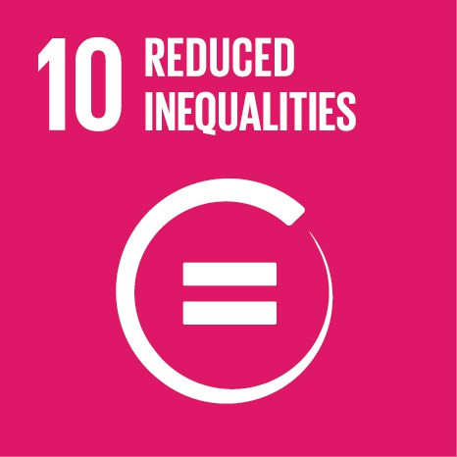
THE GLOBAL GOALS
FOR SUSTAINABLE DEVELOPMENT
REDUCE INCOME INEQUALITY WITHIN AND AMONG COUNTRIES

Slide 28
It is well documented that income inequality is on the rise, with the richest 10 percent earning up to 40 percent of total global income. The poorest 10 percent earn only between 2 percent and 7 percent of total global income.

Slide 29
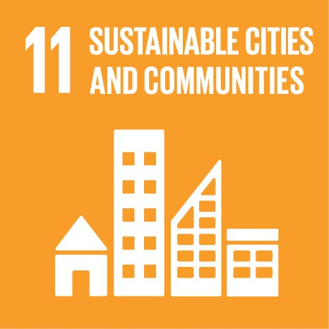
THE GLOBAL GOALS
FOR SUSTAINABLE DEVELOPMENT
MAKE CITIES AND HUMAN SETTLEMENTS INCLUSIVE, SAFE AND SUSTAINABLE

Slide 30
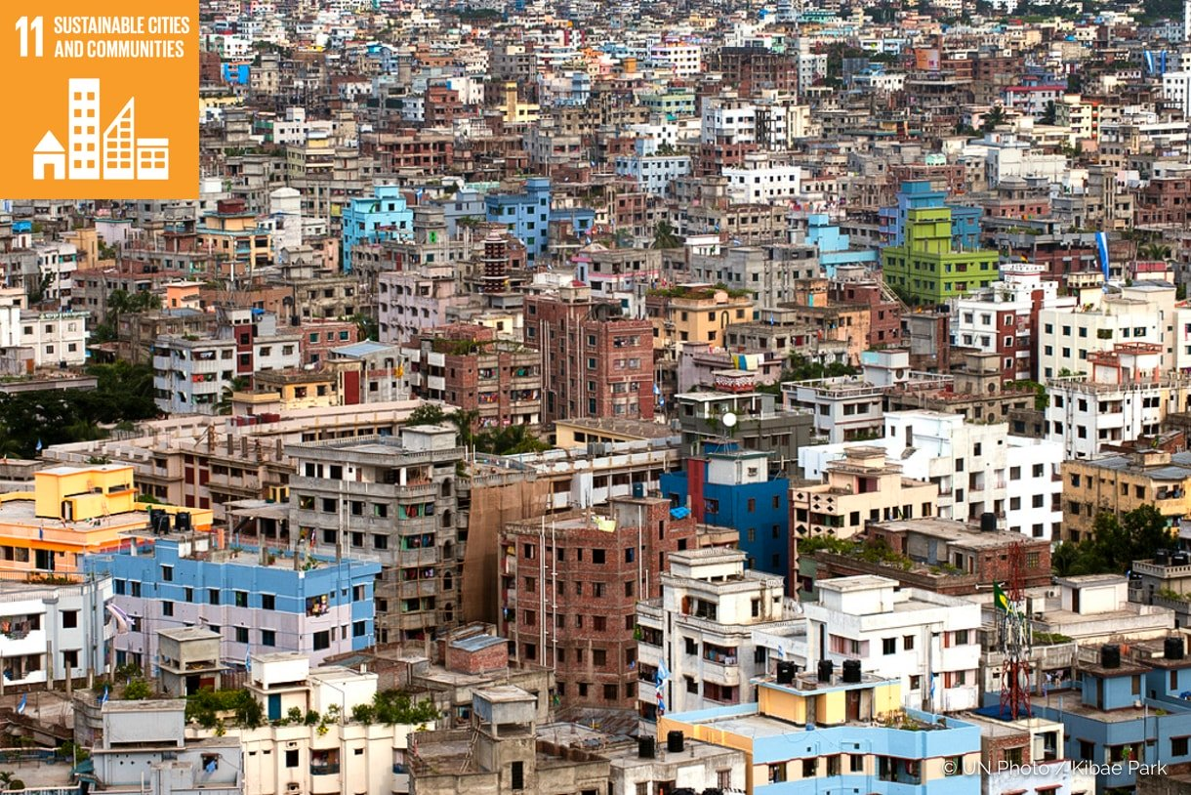

Slide 31

THE GLOBAL GOALS
FOR SUSTAINABLE DEVELOPMENT

Slide 32
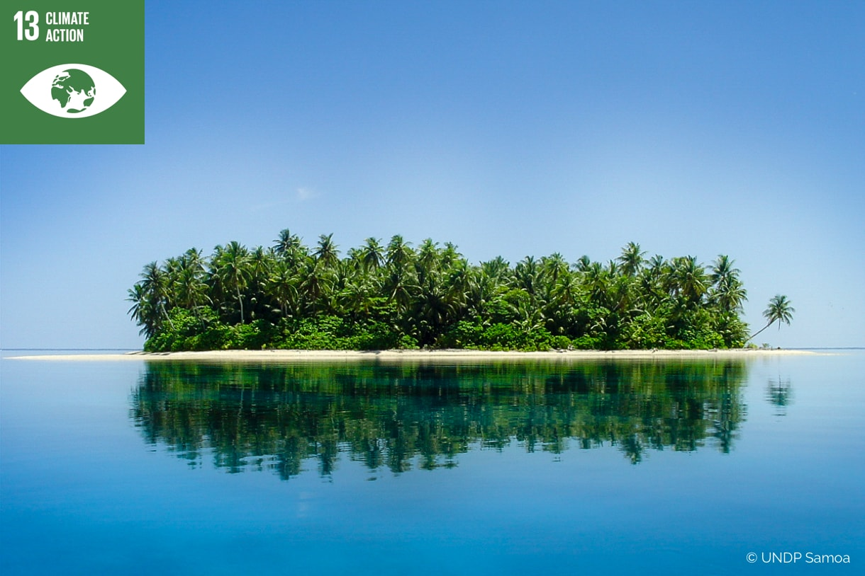

Slide 33
Further, global warming is causing long-lasting changes to our climate system, which threatens irreversible consequences if we do not take action now.
The annual average losses from earthquakes, tsunamis, tropical cyclones and flooding amount to hundreds of billions of dollars

Slide 34
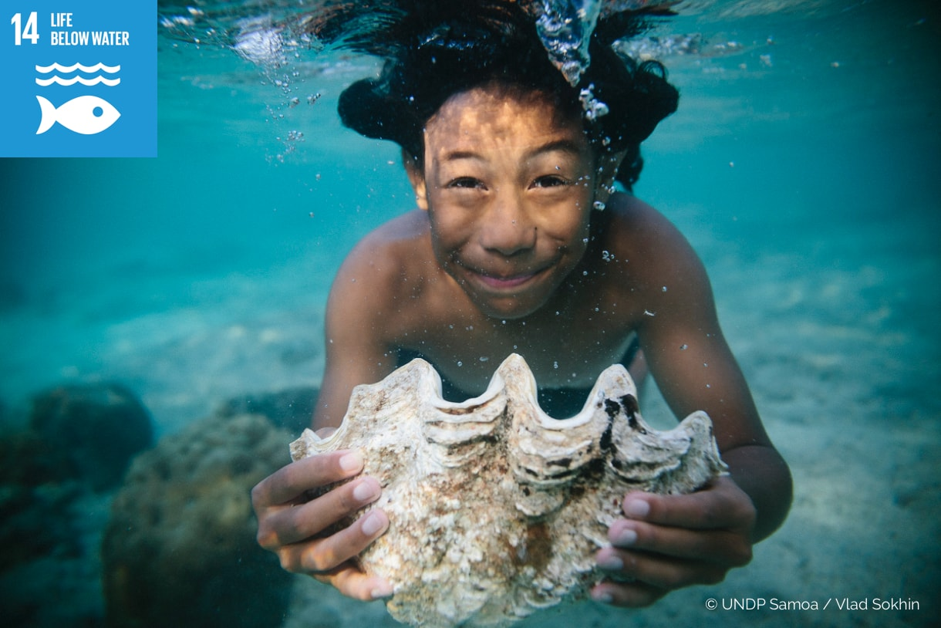
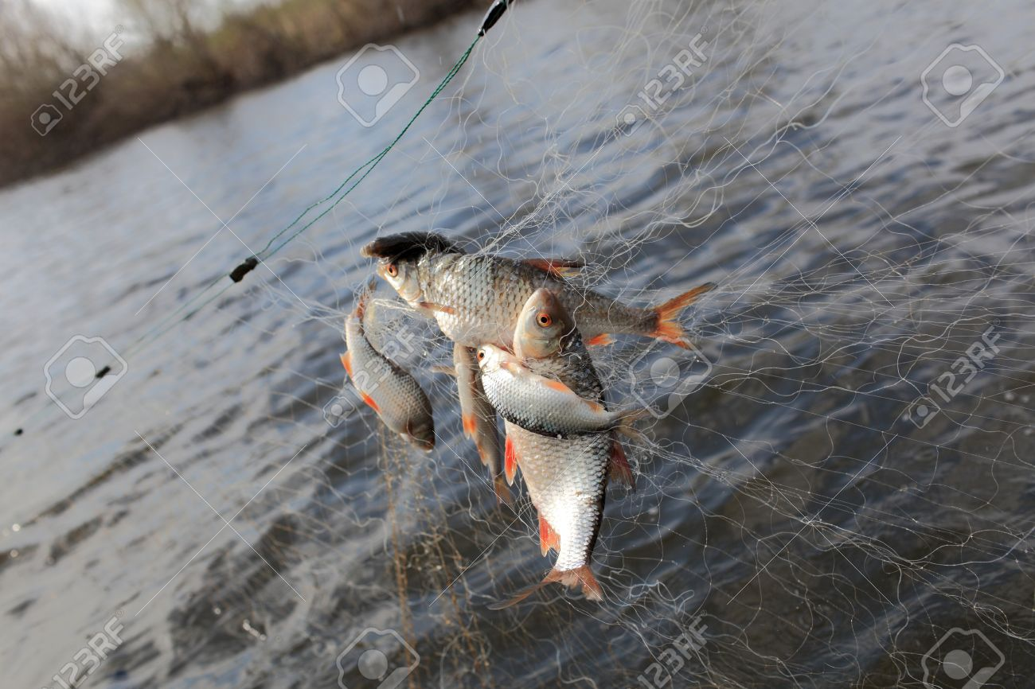
CONSERVE AND SUSTAINABLY USE THE OCEANS, SEAS AND MARINE RESOURCES FOR SUSTAINABLE DEVELOPMENT

Slide 35
The SDGs aim to sustainably manage and protect marine and coastal ecosystems from pollution, as well as address the impacts of ocean acidification.

Slide 36
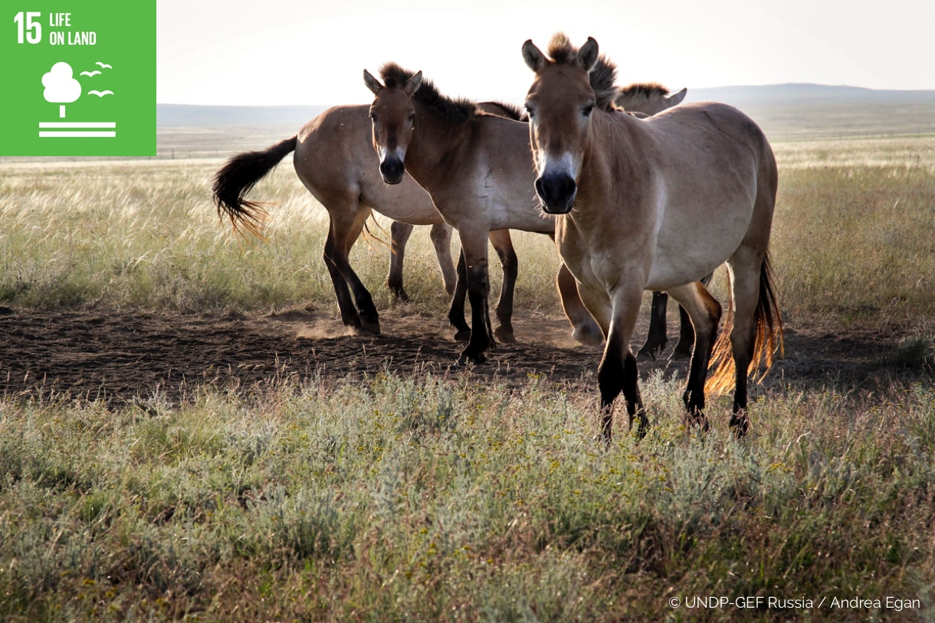
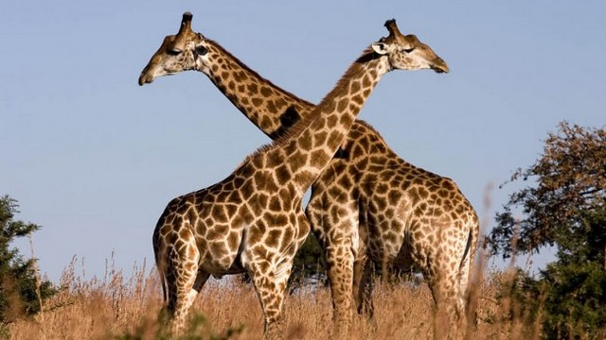

Slide 37
Today we are seeing unprecedented land degradation, and the loss of arable land at 30 to 35 times the historical rate. Drought and desertification is also on the rise each year, amounting to the loss of 12 million hectares and affects poor communities globally. Of the 8,300 animal breeds known, 8 percent are extinct and 22 percent are at risk of extinction.

Slide 38
The SDGs aim to conserve and restore the use of terrestrial ecosystems such as forests, wetlands, drylands and mountains by 2020. Halting deforestation is also vital to mitigating the impact of climate change. Urgent action must be taken to reduce the loss of natural habitats and biodiversity which are part of our common heritage.

Slide 39
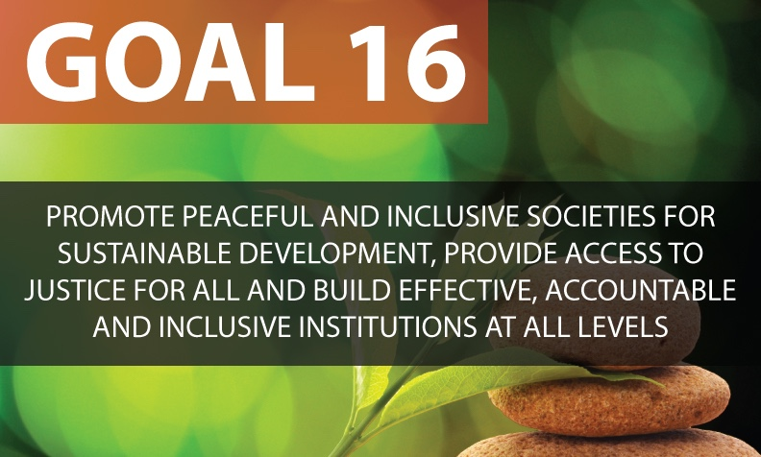

Slide 40
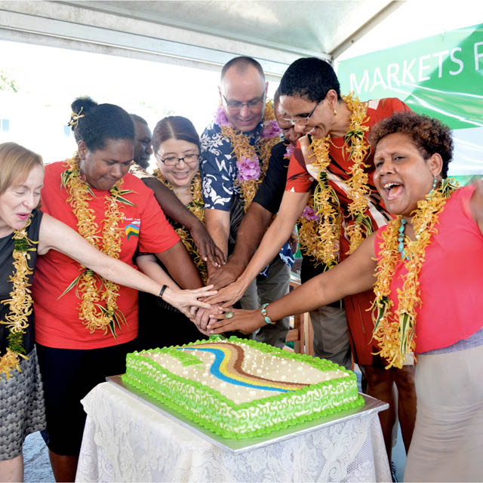
The SDGs aim to significantly reduce all forms of violence, and work with governments and communities to find lasting solutions to conflict and insecurity.

Slide 41
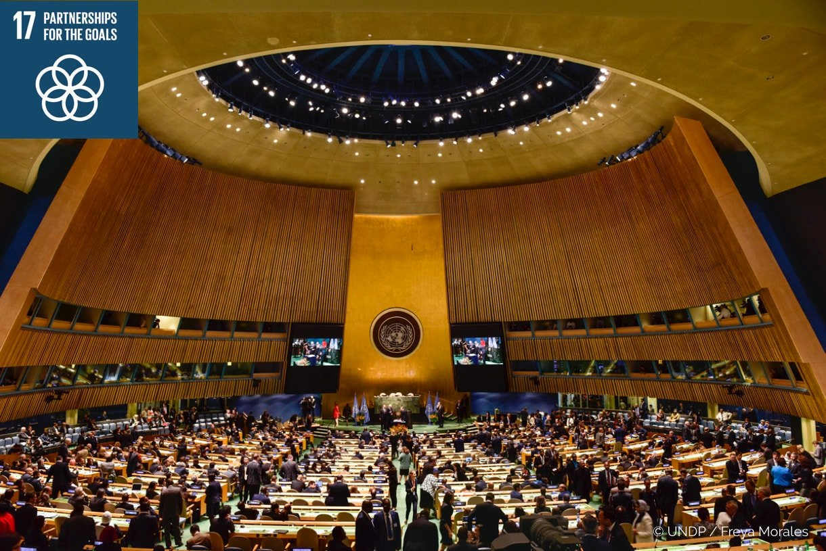

Slide 42
SDGS AND NIGERIA

Slide 43
Critique
A commentary in The Economist argued that the 169 targets for the SDGs are too many, calling them "sprawling," "misconceived," and "a mess" compared to the Millennium Development Goals.
The Economist estimated that trying to alleviate poverty and achieving the other sustainable development goals will require about US$2 trillion to 3 trillion per annum for the next 15 years.

Slide 44
RECOMMENDATION/CONCLUSION
SDGs is a global call to everyone to end poverty, protect the planet and ensure that all people enjoy peace and prosperity.

Slide 45

THANKS
“Be a global Citizen. Act with passion and compassion. Help us make this world safer and more sustainable today and for the generations that will follow us. That is our moral responsibility”

