Slide 1
CV HYPERLINKING TUTORIAL
BY
WEBOMETRICS SECTION
ICT UNIT
UNIVERSITY OF NIGERIA, NSUKKA

Slide 2
BACKGROUND
Curriculum Vitae (CV) hyperlinking is a process of liking scholarly articles in CV with the content of the articles that is in a website like google scholar. After the hyperlinking of the CVs, they will be uploaded into the website such that access can be gained to the actual research publication through the one in the CV. In this way the researchers work can be made more visible to users all over the world.

Slide 3
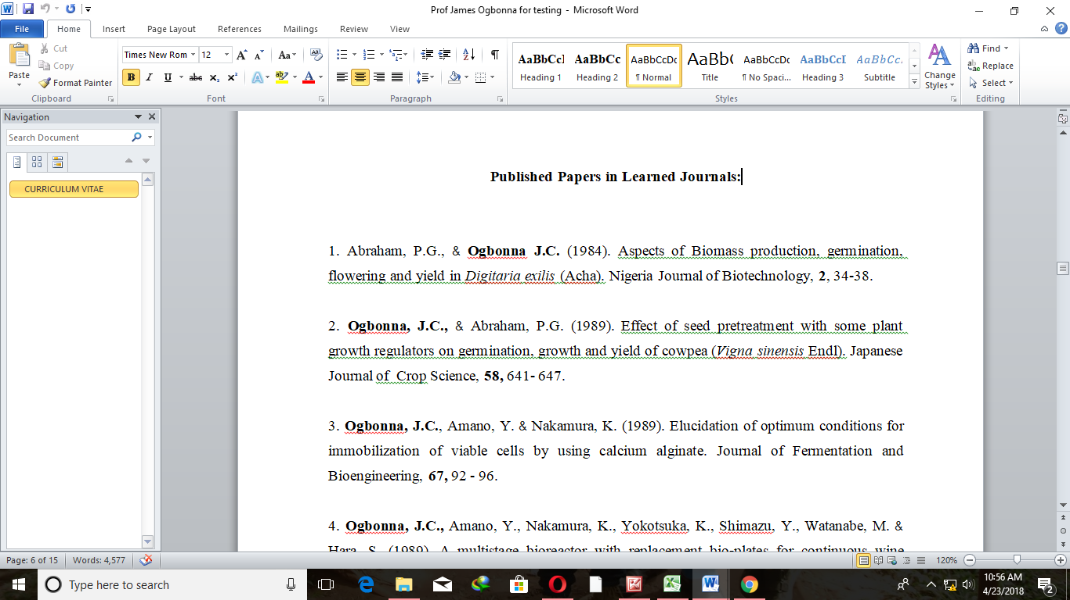
STEPS IN CV hyperlinkING
1. Open the CV you want to hyperlink in word document

Slide 4
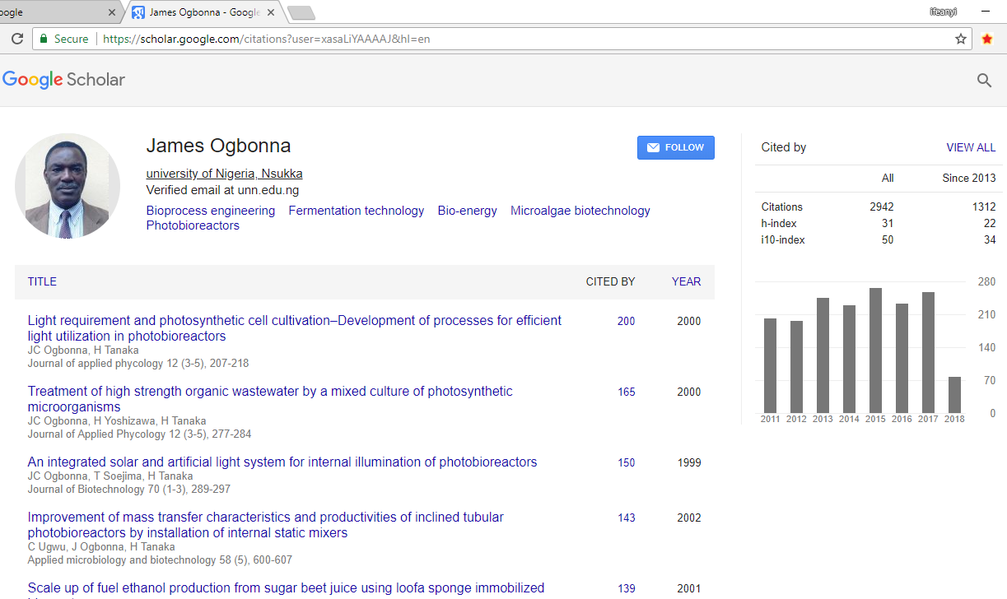
2.Open Google scholar (www.scholar.google.com)
3. Search for the name in the CV and click at it.)

Slide 5
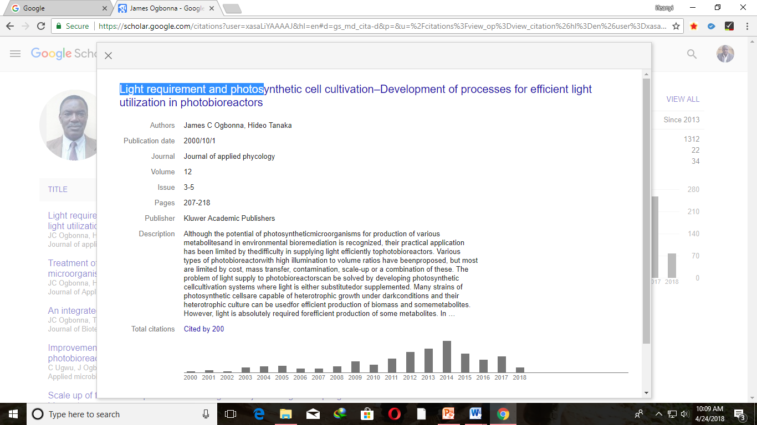
4.Click at a publication in Google scholar to open it
5.Copy the address

Slide 6
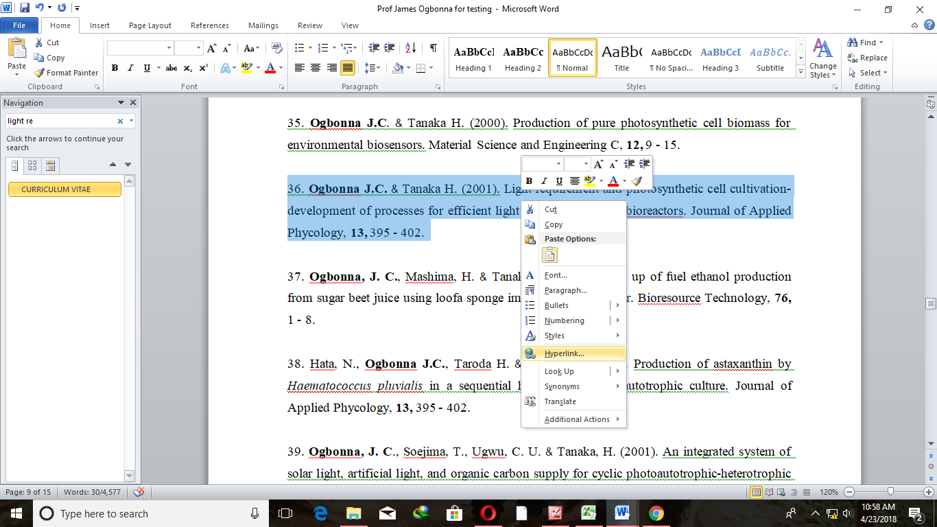
6. Go back to the CV in word document 7. Search for the particular publication that you copied its web address 8. Select the publication 9. Right click at it

Slide 7
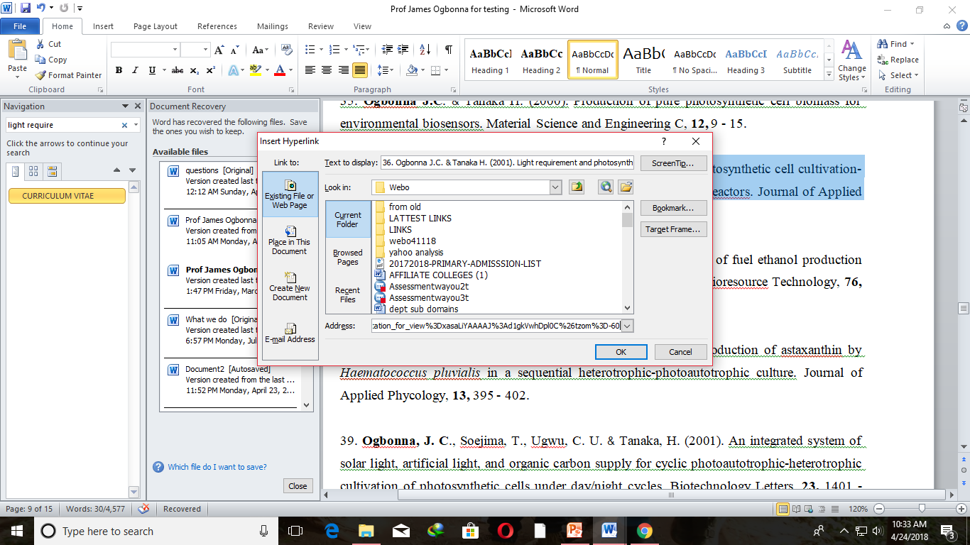
10. Click at hyperlink in the short cut menu that appears
11, Past the copied address at the address bar in the short cut window and click ok.

Slide 8
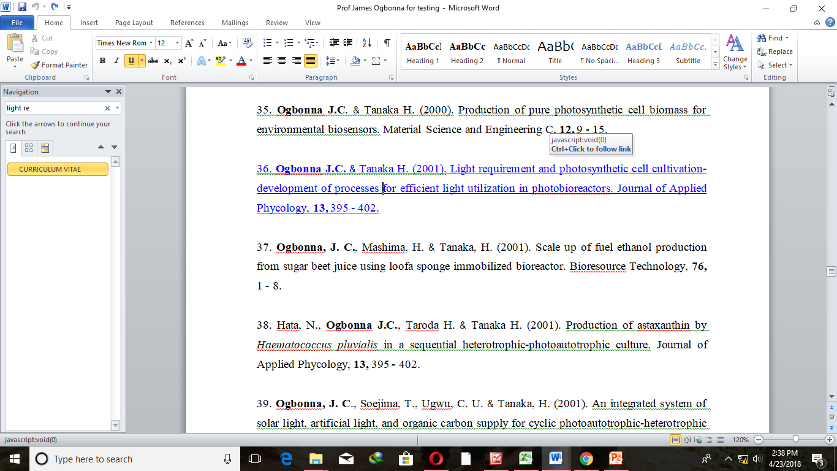
The Article turns to a link

Slide 9
Repeat this for all the publications

Slide 10
THANK YOU

